Slide 1
Setting Defaults in Microsoft Word for Accessibility
By Nancy Pabros, Educational Technologist

Slide 2
Agenda
Microsoft Word .dot File
Steps to Accessible Default Settings
Saving the Template

Slide 3
Microsoft word .dot File

Slide 4
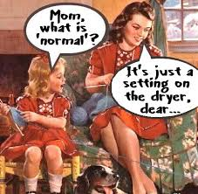
Normal Template
The default or global template used in Microsoft Word is called the normal template and is named normal.dot
When creating a New document, the normal template is loaded. Unless modified, it:
  Specifies a letter-size page with the portrait orientation and one-inch margins on all sides
  Supplies a set of styles for a new document

Slide 5
Microsoft Word .dot File Extension
.dotx is the file extension used for templates in Word 2016, 2013, 2010 and 2007
.dotm is the file extension used for templates with macros
.dot is the extension you should use if you will be sharing your template with users who have Word 97-2003.
  Documents based on this type of template will open in Word 2010 in the Compatibility Mode, which means you will not have all the Word 2010 features available to you

Slide 6


Creating a New Template (.dot File)
Start with an existing template
  OR
Start with a new or existing document
  New or existing documents will have the normal template or an existing template associated with that document
Every document has a corresponding .dot file that stores the settings and styles used or to use for that document

Slide 7
Steps to Accessible Default Settings

Slide 8
Microsoft Word Defaults for Accessibility
Microsoft Word defaults needed for accessibility are:
  Heading Styles
  Other Styles
  Alt Text short cuts
Defaults Not To Change will also be listed

Slide 9
Heading Styles
Headings are used to populate the Navigation Pane
    From the ‘View’ tab, select ‘Navigation Pane’ in the Show section
Headings create navigability for all users
  A student uses the navigation pane like an index to find sections in the document.
    Especially helpful when using a screen reader.
Heading 1 style should be the first line of the document
  There should be only one Heading 1
  This creates a quick way to get to the Top of Document
    Students not able to use a mouse use this feature

Slide 10
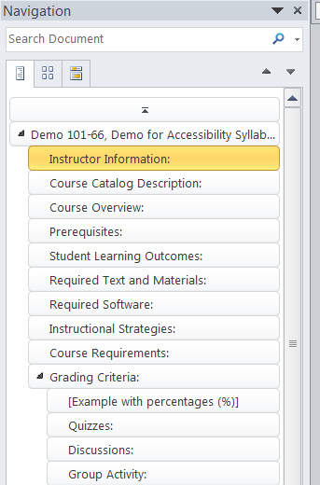
Heading Hierachy
Headings should create a hierarchical listing to navigate
  Heading 1 is first
    Top of document link
  Then Heading 2’s
  Then Heading 3’s
    Desirable for longer
    documents
  Same for Heading 4 and greater

Slide 11
Stop and Do – Heading Styles
Follow these instructions to find Heading Styles:
Open Word
  Start a new document or open an existing document
Open the Navigation Pane
  Click ‘View’ tab at the top
  Select ‘Navigation Pane’ in the Show area
Find the Styles area
  Click ‘Home’ tab at the top
  Locate the Styles area

Slide 12

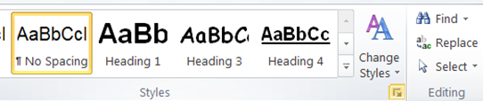
Is a Heading Missing?
After opening Word and the Styles section has Heading 1 and Heading 3, but Heading 2 is missing
  It is still available to use
  Let’s go find it!
Where’s Heading 2?

Slide 13

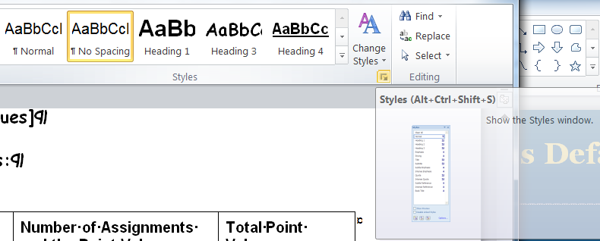
Open Styles Window
Click to Show the Styles Window (or Alt+Ctrl+Shift+S)

Slide 14
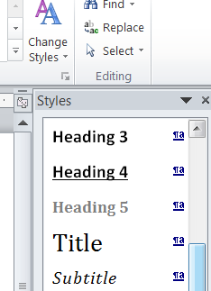
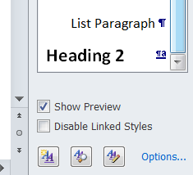
Find the Missing Heading
Scroll down to find Heading 2
…

Slide 15
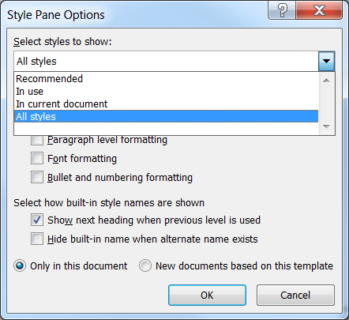
Still No Heading 2
From Styles Window, select ‘Options…’
From ‘Select styles to show:’ drop-down, select ‘All styles’
Make sure there is a check by ‘Show next heading when previous level is used’
Click ‘OK’
Heading 2 should be listed

Slide 16
Stop and Do –Styles Window
Open Styles window
  Click to Show the Styles window (or Alt+Ctrl+Shift+S)
Open Style Pane Options
  Click ‘Options…’ (at the bottom of the Styles window)
Choose the following options:
  Select styles to Show: All styles
  For ‘Select how built-in style names are shown’ choice
    Check ‘Show next heading when previous level is used’
  View options from the drop-down lists so you know what’s there
  Click ‘OK’

Slide 17
Stop and Do – Make Heading 1
At the top of the page, either highlight the “title” you have or type ‘Genesee Community College’
Change the font, size, position, and highlight to your liking
  Genesee Community College
Right-click ‘Heading 1’ Style and select ‘Update Heading 1 to match Selection’

Slide 18
Stop and Do – Make Heading 2
Add or highlight a 2nd line in your existing document that you would consider another Heading.
  If adding, type: Instructor Information:
Right-click ‘Heading 2’ Style and select ‘Update Heading 2 to match Selection’
Add or highlight a 3rd line
  If adding, type: Course Information:
Highlight ‘Course Information:’ and click (not right-click this time) ‘Heading 2’ and observe what happens

Slide 19
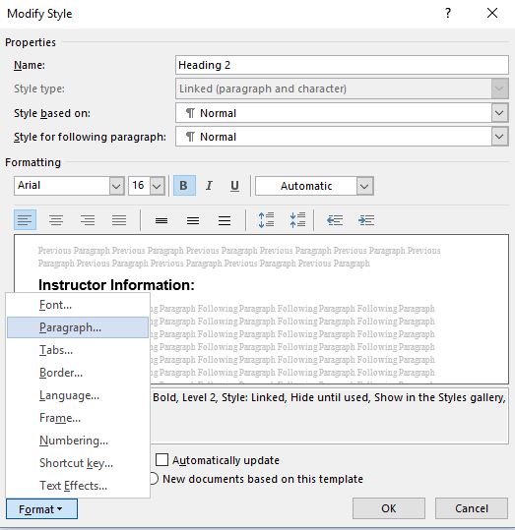
Stop and Do – Modify Heading 2
Right-click ‘Heading 2’ Style and select ‘Modify…’
  This opens the Modify Style window
  Explore the options for modifying the style
  Increase the font size
Click Format
Select Paragraph…

Slide 20
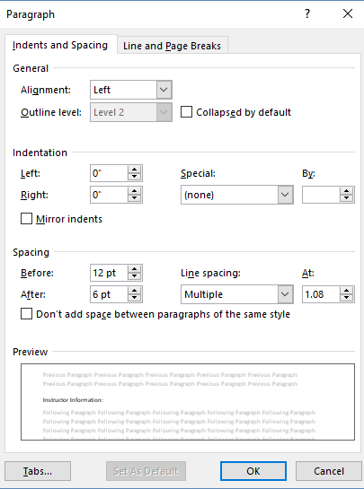
Stop and Do – Modify Heading 2, continued
Explore options for Indents and Spacing
  Make a change to ‘Spacing’ by clicking the up-arrow or down-arrow for ‘Before:’ to be ’12 pt’ and for ‘After:’ to be ‘6 pt’
Click ‘Ok’
Observe the change is done to both Heading 2’s

Slide 21
Alt Text Short Cuts
Alternate text is a text representation of a non-text item.
Alternate text can be:
  Preceeding text
  A caption for a table, chart, image, etc.
  Done using the Alt Text command
    This is how you get text when you hover over an image
    Is text that can be read by a screen reader
  Adding the Alt Text short cut to the Quick Access Toolbar makes it easier to use.
If interested in learning more about Alternate Text, please view my presentation on the Online Learning Faculty Resources page.
Notes:
Scroll down on the Online Learning Faculty Resources page to find the ‘Adding Alternate Text to Microsoft Documents for Accessibility’ presentation: https://www.genesee.edu/cms/home/assets/File/Adding%20Alternate%20Text%20to%20Microsoft%20Documents%20for%20Accessibility%20-%20PAD.pptx

Slide 22
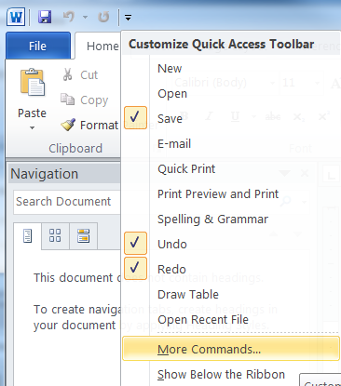
Add Alt Text to the Quick Access Toolbar
In the upper-left corner above the Ribbon, click Customize Quick Access Toolbar down-arrow icon
Select ‘More Commands…’
Or
File > Options
Select ‘Quick Access Toolbar’
Notes:
Instructions shown are from the Microsoft help page at https://support.office.com/en-us/article/Add-alternative-text-to-a-shape-picture-chart-table-SmartArt-graphic-or-other-object-44989b2a-903c-4d9a-b742-6a75b451c669.
For PowerPoint and Word 2010:
Once you Select (click on the non-text content or object), the top menu bar adds ‘Drawing Tools’ or ‘Picture Tools’
Select or click the icon to expand that sub-menu to the Format Shape, Format Picture, etc. Properties box.
Select Alt Text and continue as shown before

Slide 23
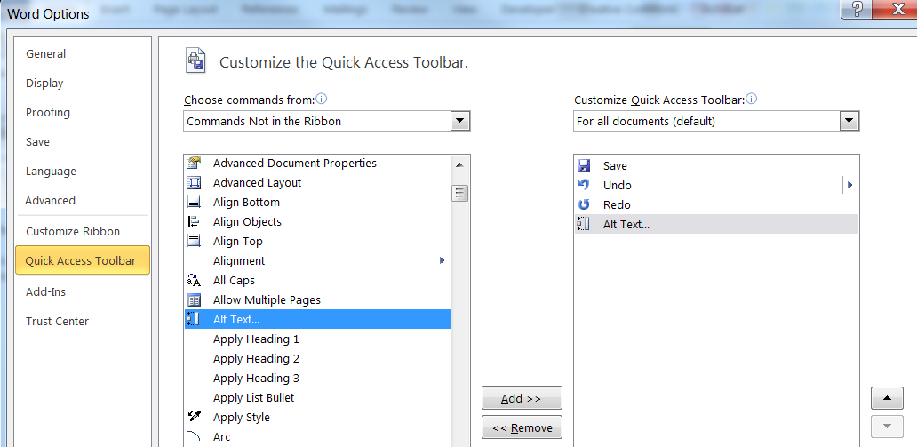
Add Alt Text to the Quick Access Toolbar, continued
Under ‘Choose commands from:’ select ‘Commands Not in the Ribbon’ or All
Click ‘Alt Text’
Click ‘Add >>’
Click ‘OK’
Notes:
When it is easier to use, you are more likely to use it!

Slide 24

Alt Text Added to the Quick Access Toolbar
When it is easier to use, you are more likely to use it!
Format Picture, Format Chart Area, and Format Shape > Alt Text
For Table Alt Text, add ‘Table Properties’
  Under Choose commands from:, select ‘All Styles’ or ‘Table Tools | Layout Tab’ and Click ‘Add >>’
Notes:
This is worth repeating: When it is easier to use, you are more likely to use it!

Slide 25
Stop and Do – Add Alt Text to Quick Access Toolbar
Click Customize Quick Access Toolbar down-arrow icon and select More Commands… (or File > Options, Select ‘Quick Access Toolbar’)
Under ‘Choose commands from:’ select ‘Commands Not in the Ribbon’ or All
Click ‘Alt Text’
Click ‘Add >>’
Click ‘OK’

Slide 26
Defaults Not To Change
The following are defaults not to change (already accessible):
Margins
  The default margin setting of 1” margins
Automatic numbering features
  If turned off, lists need to be manually added with paragraph functions
  Optionally make changes with accessibility in mind
Notes:
When it is already accessible, don’t change it!

Slide 27
Word Template Accessibility Summary
Readability, usability, and navigability are all important in terms of accessibility
  Heading Styles populate the Navigation Pane
  Styles create a way to keep like things consistent throughout the document
  Leave Margins as defaulted with the Normal setting (1” borders all around)
Providing consistency is important for students with vision and learning disabilities. Providing alternate text for those with hearing and learning disabilities is necessary. Default settings can help provide these.

Slide 28
Saving The Template

Slide 29
Use This Template for New Documents
Click to Show the Styles Window (or Alt+Ctrl+Shift+S)

Slide 30
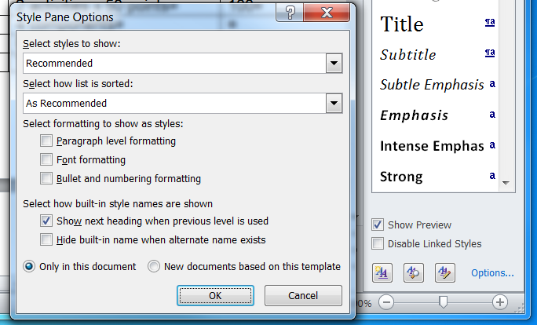
Use This Template for New Documents, continued
Click ‘Options…’
  To Open Style Pane Options Pop-up
Select radio button for ‘New documents based on this template’
Click ‘OK’

Slide 31
Save and Use as a Template
Save the changes as a template file
  File > Save As
  Save as type: Choose “Word Template (.dotx)”
Everything is saved (‘New Documents based on this Style’ saves just Styles)
  If you type something in the document, add header or footer content, change margins (but don’t do that!), etc. that will get saved too.
Ideas for templates to create and reuse:
  Syllabus
  Student Hand Book

Slide 32
Stop and Do – Save the Template
Click to Show the Styles Window (or Alt+Ctrl+Shift+S)
Click ‘Options…’
Select ‘New documents based on this template’
Click ‘OK’
Click ‘File’ > ‘Save As’ and choose “Word Template (.dotx)”
  Everything that was typed (Headings, etc) will be in this template file

Slide 33
Setting Defaults for Accessibility Summary
The Microsoft Word .dot file was described
Steps to Accessible Default Settings were shown
Saving the Template as a .dotx file or save the Heading settings

Slide 34
Stop and Do - Extras
Create a new document and observe the changes
  Heading Styles will be those you saved
  Alt Text will be in the Quick Access Bar
Update an existing document and make these accessibility changes
  Create Headings

Slide 35
Questions?
Notes:
I’m also available for any accessibility questions.
Nancy Pabros, nlpabros@genesee.edu, x6112

Slide 36

Feedback Is Appreciated
Thank You!
Notes:
Feedback forms are available to fill out or send comments to GCConline@genesee.edu

