Slide 1
Document Accessibility: What Color is Your Gauge?
By Nancy Pabros, Educational Technologist

Slide 2
Agenda
About the Gauge
The Law and 508 Compliance
Accessibility “Top 10”
Accessibility Checker Instructions
Accessibility Checker Inspection Results
  ERRORS
  WARNINGS
  TIPS
Manual Testing Checklist
Lab

Slide 3



What Do the Gauge Colors Mean?
In Blackboard, the Ally Gauge has appeared for documents!
What do the colors mean?
    Green means it programmatically has passed accessibility checks
      Still needs manual checks
    Orange/Yellow means it needs work
    Red means it need some more work than orange/yellow

Slide 4

The Law and 508 Compliance
ADA (Americans with Disabilities Act)
  ADA is about access.
Rehabilitation Act
  Section 504 – requirements for individuals
  Section 508 – accessibility standards for electronic and information technologies
Course materials and anything student facing must be 508 compliant

Slide 5
508 Compliance
The goal is to comply with the government’s 508 Checklist
The Ally Gauge in Blackboard and the Microsoft Accessibility Checkers are great starting points when identifying accessibility issues.
  After these programs find issues, manual checking is still important

Slide 6
Strengthening Your Documents for Accessibility
For Microsoft products (Word, PowerPoint, Excel, etc.)
  Use the built-in Accessibility Checker
  Manually check the document

Slide 7
Accessibility “Top 10” Course Material List Quick Review
Include the Accessibility Statement
Keep Content Simple
Use Headings (Styles)
Use Color and Contrast Thoughtfully
Review Accessibility Checker Suggestions
Audio & Video Need Transcripts or Captioning
Hyperlinks Need to Make Sense
Provide Alternate Text
The More Ways the Better!
Consistency, Consistency, Consistency…
Notes:
Accessibility Self-Review Checklist (www.genesee.edu/cms/home/assets/File/Accessibility%20Self%20Review%20Checklist.docx) to show:
Accessibility Statement
Keep Content Simple
Headings (https://www.genesee.edu/cms/home/assets/File/Setting%20Defaults%20in%20Microsoft%20Word%20for%20Accessibility.pptx)
Color and Contrast
Accessibility Checker
Audio Transcripts and Video Captioning
Hyperlinks
Alternate Text (https://www.genesee.edu/cms/home/assets/File/Adding%20Alternate%20Text%20to%20Microsoft%20Documents%20for%20Accessibility%20-%20PAD.pptx)
The More Ways the Better!
Be Consistent

Slide 8
Document Accessibility: Review Accessibility Checker Suggestions
Include the Accessibility Statement
Keep Content Simple
Use Headings (Styles)
Use Color and Contrast Thoughtfully
Review Accessibility Checker Suggestions
Audio & Video Need Transcripts or Captioning
Hyperlinks Need to Make Sense
Provide Alternate Text
The More Ways the Better!
Consistency, Consistency, Consistency…

Slide 9
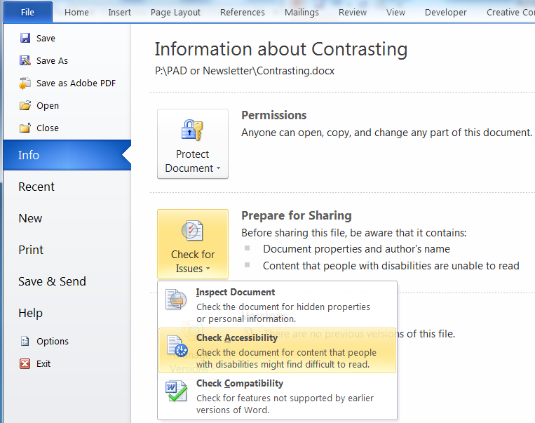
Microsoft Word Accessibility Checker Instructions
For Microsoft Word 2010 and 2013, select:
File
Info
Check for Issues
Check Accessibility

Slide 10
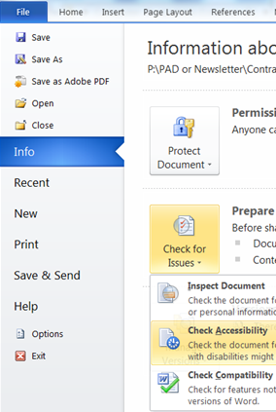
Stop and Do:
Accessibility Checker Instructions
Open an existing Word document
    Click File
    Click Info
    Click Check for Issues
    Click Check Accessibility

Slide 11
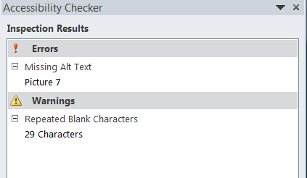
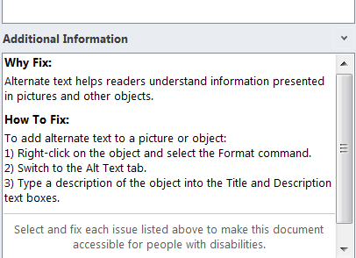
Accessibility Checker Inspection Results
Inspection Results show:
  ERRORS
  WARNINGS
  TIPS
  Select the Error, Warning, or Tip content:
    Cursor will be placed at that spot
    Additional Information will show specific to that Inspection Result
Additional Information shows:
  Why Fix
  How To Fix
When fixed they disappear from the list

Slide 12
Accessibility Checker Inspection Results: ERRORS
Inspection Result ERRORS:
Includes content that is very difficult or perhaps impossible for people with disabilities to understand.
Must be fixed for accessibility or determined to be addressed in another accessible way

Slide 13
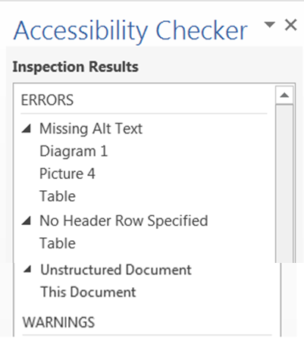
Accessibility Checker Inspection Results: ERRORS continued
Inspection Result ERRORS Include:
Missing Alt Text
  For Diagrams, Pictures, Tables, etc.
No Header Row Specified
  For tables
Unstructured Document
  This Document

Slide 14
Accessibility Checker ERRORS:
Missing Alt Text
Why Fix:
Alternate text helps readers understand information presented in pictures and other objects
Include alternate text with all visuals (pictures, clip art, Smart
Art, graphics, shapes, groups, charts, embedded objects, ink, and videos)
How to Fix:
Right-click on the object, and click Format
Click Layout & Properties
Expand the Alt Text section
Type a description of the object into the Title and Description boxes
Notes:
Find

Slide 15
Accessibility Checker ERRORS:
Missing Alt Text continued
Exception to the Rule:
When an image is decorative it doesn’t need alternate text.
  A space can be added in the description field creating a ‘blank’ or ‘null’ alternate text
Notes:
Find

Slide 16
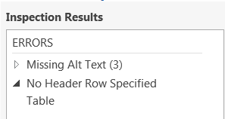
Accessibility Checker ERRORS:
No Header Row Specified
Why Fix:
Column headings provide context and
aid navigation of the data in a table
When heading rows are not defined,
non-sighted users may have difficulty
identifying the meaning of data cells and
how they relate to other data in the table.
How to Fix:
  Select the table and highlight the top header row(s)
  Click on the Table Tools | Layout tab
  Click Repeat Header Rows in the Data area

Slide 17
Accessibility Checker ERRORS:
No Header Row Specified continued
Exceptions to the Rule:
The table doesn’t have (or really need) headings for the content to make sense or for readability.
The content can also be represented as:
  Blue Things
    Sky
    Blueberries
    My Car
  Red Things
    Some fruit
    Stop signs
Blue Things | Sky Blueberries My car
Red Things | Some fruit Stop signs

Slide 18
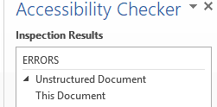
Accessibility Checker ERRORS: Unstructured Document
Why Fix:
  Use headings to create structure and make it easier for users to find information in your document
How to Fix:
  Headings are used to populate the Navigation Pane
    From the ‘View’ tab, select ‘Navigation Pane’ in the Show section
  Add style Heading 1 for top of page
  Add styles Heading 2, 3, etc. to create a hierarchical navigation structure (like an index) to easily access sections in the document
Notes:
There’s a presentation for that: https://www.genesee.edu/cms/home/assets/File/Setting%20Defaults%20in%20Microsoft%20Word%20for%20Accessibility.pptx

Slide 19
Extra: PowerPoint ERROR
ERROR
  All slides have titles
Best Practice:
  PowerPoint slides each need a unique title
  Like Heading Styles, unique titles help with navigation of PowerPoint slides

Slide 20
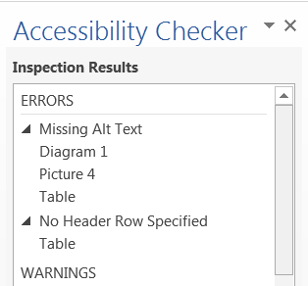

Stop and Do: ERRORS Check and Fix
Fix ERRORS found in your document:
  Missing Alt Text for Diagrams, Pictures, Table, etc.
  No Header Row Specified for Tables
  Unstructured Document
Note: Select and fix each issue listed above to make this document accessible for those with disabilities.

Slide 21
Accessibility Checker Inspection Results: WARNINGS
Inspection Result WARNINGS:
Includes content that is could be difficult for people with disabilities to understand.
Ideally, these items should be fixed to strengthen your document for accessibility or determined to be addressed in another accessible way

Slide 22
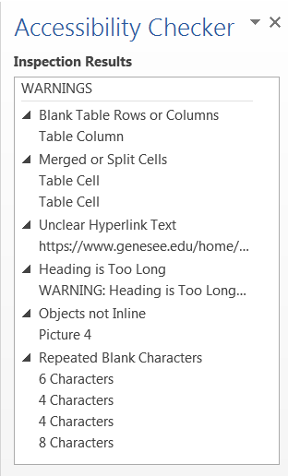
Accessibility Checker Inspection Results: WARNINGS continued
Inspection Result Warnings:
Must be fixed or acknowledged to be correct for accessibility
  There are exceptions to rules
Includes:
  Blank Table Rows or Columns
  Merged or Split Cells
  Infrequent Headings
  Unclear Hyperlink Text
  Heading Too Long
  Objects not Inline
  Repeated Blank Characters

Slide 23
Accessibility Checker WARNINGS:
Blank Table Rows or Columns
Best Practice:
All tables must not have blank rows or columns
Why Fix:
When tables contain blank rows or columns, it is difficult for non-sighted users to understand and navigate through the table.
Blank table cells can mislead a person with a vision disability into thinking there is nothing more in the table.

Slide 24
Accessibility Checker WARNINGS:
Blank Table Rows or Columns continued
How to Fix:
Delete unnecessary blank cells.
OR
If you table is only intended to layout content in your document, clear all table styles from your table.
To clear styles:
Select the entire table
Click on Table Tools | Design tab
Expand the Table Styles gallery and click Clear on the menu below the gallery

Slide 25
Accessibility Checker WARNINGS:
Merged or Split Cells
Why Fix:
Tables should have simple two-dimensional structure for easier navigation and ability to be understood by people with disabilities
  This WARNING will also appear when you nest tables (embed a table in a table cell)
How to Fix:
Click the cell that is split
On the Layout tab, click Merge Cells in the Merge area
Choose the proper merge criteria
OR
Click the cell that is merged and choose Split Cells in the Merge area

Slide 26

Accessibility Checker WARNINGS:
Infrequent Headings
Best Practice:
Headings spaced evenly throughout a document create structure and make it easier for readers to find information and navigate the document.
Make sure you have at least one heading every two pages or so, and that your headings are ‘organized’ correctly (Heading 2 under Heading 1, etc.)
How to Fix:
Find a body of text which is not preceded by a text in a heading style.
Add a line of text between sections and use the Styles gallery on the Home tab to select a heading style.
Click on the View tab and click the Navigation Pane checkbox to see a list of your document’s overall heading structure.

Slide 27
Accessibility Checker WARNINGS:
Unclear Hyperlink Text
Best Practice:
Add meaningful hyperlink text and Screen tips
Why Fix:
Hyperlink text should provide a clear description of the link destination instead of providing only the URL

Slide 28
Accessibility Checker WARNINGS:
Unclear Hyperlink Text Continued
How To Fix: To make the hyperlink text more accessible:
Select the link and click Hyperlink on the Insert tab to open the edit Hyperlink dialog.
  Or select the words or entire hyperlink, right-click, and select Hyperlink…
Type a phrase in the Text to display: field which will briefly describe the link destination.
The Address: field is the URL address including http(s)://
Note: You can also click Screen Tip in the Edit Hyperlink dialog to add a meaningful description to the hyperlink. The Screen Tip text appears when your cursor hovers over text or images that include a hyperlink.
Exception to the rule:
When you expect the document to be printed, the link needs to be stated in its entirety

Slide 29
Accessibility Checker WARNINGS:
Heading Too Long
Best Practice:
Headings need to be descriptive but not too long. Up to 2 lines is a good guideline with 1 line preferred.
Even though Heading Too Long is not a requirement, it is good to fix to strengthen your document for accessibility.
Why Fix:
Short, concise headings make it easier for people with disabilities to quickly navigate the document structure.
How to Fix:
Shorten long titles to concise words or short phrase. Add subsequent information to content under title.

Slide 30
Accessibility Checker WARNINGS:
Repeated Blank Characters
Best Practice:
Use indent, tab stops, or built-in table function instead of space, space, space and tab, tab, tab to line up data.
Use paragraph and avoid using multiple carriage returns (Enters) to get paging
Why Fix:
Any extra “blanks” (spaces, tabs, and empty paragraphs) may be perceived as the end of the information.
Older screen readers may stop reading when multiple spaces are encountered

Slide 31
Accessibility Checker WARNINGS:
Repeated Blank Characters continued
How To Fix:
Use formatting, indenting, and styles to create whitespace instead of repeating blank characters.
To use formatting to add whitespace around a paragraph:
  Remove any existing whitespace around the paragraph
  Select the text, then right-click and choose Paragraph.
  Select values for Indentation and Spacing to create whitespace
To un-anchor an image that you added multiple carriage returns behind
  Select the image, right-click, select Wrap Text, select ‘In Line with Text’

Slide 32
Extra: Excel WARNING
WARNING
  Sheet tabs have meaningful names
Best Practice:
  Rename the ‘Tab 1’ to be a meaning unique name for the worksheet

Slide 33
Stop and Do: WARNINGS Check and Fix
Fix WARNINGS in your document:
  Blank Table Rows or Columns
  Merged or Split Cells
  Infrequent Headings
  Unclear Hyperlink Text
  Heading Too Long
  Objects not Inline
  Repeated Blank Characters

Slide 34
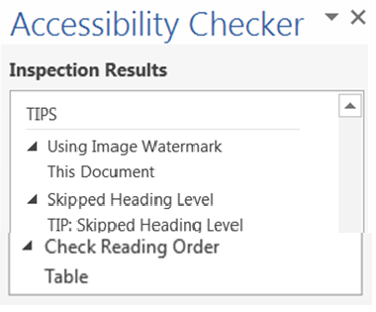
Accessibility Checker Inspection Results: TIPS
Inspection Result TIPS:
Includes:
  Using Image Watermark
  Skipped Heading Level
  Check Reading Order

Slide 35
Accessibility Checker TIPS:
Using Image Watermark
Why Fix:
Images used as watermarks may not be understood by people with vision or cognitive disabilities.
How to Fix:
Watermarks cannot be made accessible. Make sure the information included in the watermark is also included elsewhere in the document.

Slide 36
Accessibility Checker TIPS:
Skipped Heading Level
Best Practice:
Check Navigation pane for readability
  It can show if entire sections are missing (acts like an Index does)
Why Fix:
This Navigation Pane is used for navigability in a document
Using heading levels in logical order makes it easier for readers to find information and navigate the document.

Slide 37
Accessibility Checker TIPS:
Skipped Heading Level continued
How to Fix:
Open the Navigation Pane (Click View tab and select Navigation Pane in the Show area)
Find skipped heading and change Style appropriately
Exception to the rule:
Does it make sense being skipped? If so, it is a TIP and just a suggestion to strengthen the document for accessibility.

Slide 38

Accessibility Checker TIPS:
Check Reading Order
Why Fix:
Tables used for layout should present information in a meaningful order from the first cell to the last
How to Fix:
Verify the table reading order by tabbing through cells and ensuring the information is presented in an order that make sense.
Note: If this table is meant to show lists or structured data, apply a table style from the Table Styles gallery on the Table Tools | Design tab.

Slide 39
Extra: PowerPoint TIPs
TIP
  Ensure reading order is logical
  Ensure each slide has a unique title
Best Practice:
  Open selection order pane and make sure reading order is read correctly
TIP
  Ensure each slide has a unique title
Best Practice:
  Unique title allows those using assistive technologies a way to distinguish slides.

Slide 40
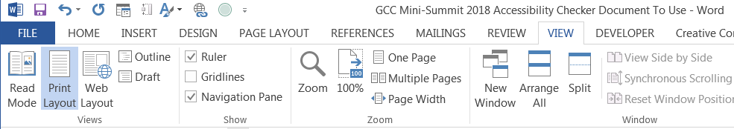
Stop and Do: TIPS Check and Fix
Open the Navigation Pane:
  Click View
  Select Navigation Pane in the Show area
Correct any Skipped Heading Levels

Slide 41
Manual Testing
The Accessibility Checker is a program and can check only that allowed by a program to check
Manual testing is still needed to ensure your documents are strengthened even more for accessibility

Slide 42
Manual Testing Checklist
Manual Testing Checklist includes:
  List formatting
    Use built-in formatting tools for bulleted and numbered lists
  Language settings
    Needed for accessibility check for pdf files
  Document properties
  Color and contrast
  Complex tables
    Make sure they read properly with assistive technologies (such as a screen reader)
  Check if using unclear (for example: Click here) hyperlinks
  Adding hierarchical structure to documents using Headings and Styles
  Blank table entries may confuse a screen reader that it is at the end of the content

Slide 43
Accessibility Drop-In or Review
Need help after today?
Spring 2019 Semester Accessibility Drop-in:
  Where: Room T134
  When: Wednesdays at 2:00-3:00
    Or by appointment
Strengthen your course with a Quality and Accessibility Review
  Sign up on the Online Learning Faculty Resources page
    www.genesee.edu/home/offices/online/faculty-resources/

Slide 44
Lab Time
If you do not already have a file open:
  Log in and access your P:\ drive
  Grab a file – any file – and run the Accessibility Checker
    File -> Check for Issues -> Check Accessibility

Slide 45
Questions?
I’m also available for any accessibility questions.
Nancy Pabros, nlpabros@genesee.edu, x6112, T133
Notes:
I’m also available for any accessibility questions.
Nancy Pabros, nlpabros@genesee.edu, x6112
This presentation ca be found at http://www.genesee.edu/home/offices/online/faculty-resources/, our Faculty Resources section of the Online Learning web page.
Please note the YouTube videos produced by Online Learning are also available for alternate text and other accessibility features.

Slide 46

Feedback Is Appreciated
Thank You!
Notes:
Feedback forms are available to fill out or send comments to GCConline@genesee.edu

