Slide 1
Is Your Syllabus Accessible?
By Nancy Pabros, Educational Technologist
Notes:
Resources:
Accessibility Self-Review Checklist and Online Learning Faculty Resources page
Accessibility Self-Review Checklist (www.genesee.edu/cms/home/assets/File/Accessibility%20Self%20Review%20Checklist.docx)
Online Learning Faculty Resources (http://www.genesee.edu/home/offices/online/faculty-resources/)

Slide 2
Accessible Course Materials
Consider the readability, usability, and navigability of all documents and materials you put in your course.
  Students using assistive technologies (such as screen readers) need text or text representations to be able to ‘see’ the same content. Students with mobility impairments (such as being unable to use a mouse) need the same access. And, so on…
This presentation shows guidelines to create or strengthen your Syllabus keeping accessibility in mind!

Slide 3
Agenda
The following topics will be presented:
  Best Practices for Readability
  Best Practices for Usability
  Best Practice for Navigability
    Each section above will show how to discover issues and steps how to create or strengthen your syllabus for Accessibility
  Syllabus Must-Have

Slide 4
Best Practices for Readability
For readability, follow the recommendations and steps for:
  White space usage
  Fonts and font sizes
  Page orientation
  Highlighting
  Color and contrast usage
  Hyperlinks
  Images and alternate text
Notes:
The list looks quite long, but shouldn’t be overwhelming as most items will be common sense or a reminder as to what to look for after, but what you can do when composing your materials as well. These are items you build in to your content from the beginning each time, not retrofit after.
Simple tweaks to your content can go a long way in providing accessibility.

Slide 5
Readability: White Space Usage
Balance white space to help students with visual impairments and learning disabilities.
Break up large overwhelming blocks of text
  For example, use bullets when listing items
Keep margins at Normal (1” all around)
Left-justify
  Avoid center, except for Titles or Headings
  Avoid full-alignment, except for newspaper articles
Extra spaces may be perceived as the end of the information
  Assistive technologies, like a screen reader, could stop
Notes:
Blocks of large text are hard to read by those with visual impairments or learning disabilities where smaller blocks of information is needed for understanding.
Bottom margin space is also important to allow for caption space if doing a voice-over.
When full-alignment is used, there is a variable spacing between words and also the spacing between letters in words that is inconsistent. You do not want the reader to question why the spacing is different.

Slide 6
Readability: White Space Usage, Continued
How to check white space issues:
Check margins on Page Layout tab
Visual Inspection for:
  Large blocks of text
  Blank pages (not caught by accessibility checker)
  Left-justification

Slide 7
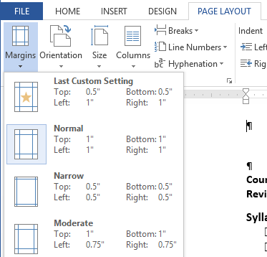
Stop and Do: White Space Usage
Login and go to your P:\\ drive and open your Syllabus (or another document)
Check margins
  Go to the Page Layout tab
  Click Margins drop-down list
  If not Normal setting selected, then select Normal
    If you use Section Breaks within your document, select (Ctrl-A) the entire document first

Slide 8
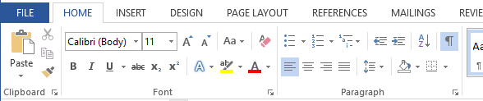
Stop and Do: White Space Usage, Continued 2
Turn on Paragraph marks to check for extra spaces, tabs, breaks, etc.
    Note: when you cut & paste from the Internet (including Blackboard), some strange formatting can occur and this will show with Paragraph marks on.
  Fix extra spaces by using tab stops
  Fix extra tabs by using a single tab stop or make it a table
Visual Check for large blocks of text

Slide 9
Readability: Fonts and Font Sizes
For Fonts:
Be consistent
  Either use simple san-serif (without tail) or serif fonts
    San-serif is best for viewing online.
    Serif or san-serif are good when expecting document to be printed.
12 pt at a minimum
  Even for tables
For Font Sizes:
Be consistent
  Use Styles to keep Headings and like items consistent throughout
    Word processing programs (MS Word, Google Docs, etc. have Styles)
    Being consistent is only a click away ☺

Slide 10
Readability: Fonts and Font Sizes, Continued
How to discover fonts and font size issues:
Visual inspection
Notes:
There is no program out there to tell you you’ve used a different font for a heading or pinpoint that you should consider a san serif font or the font size in a table is to small for the general reader. Again, if you build consistency and accessibility in your documents from the beginning, you will begin to see that cut & paste differerent font or font size more readily.

Slide 11
Readability: Page Orientation
Portrait vs. Landscape Guidelines:
Use portrait page orientation for general text
Landscape can be used for large tables (such as a course schedule) to make it readable when keeping font size at 12 pt
If avoidable, don’t change between portrait and landscape within a document
  Adding a landscape Course Schedule at the end of the Syllabus is acceptable
  Switching multiple times without warning is not accessible
Notes:
Show of hands: How many have printed an email or document in landscape and found it hard to read?

Slide 12
Readability: Page Orientation, Continued
How to discover page orientation issues:
Visual inspection

Slide 13

Readability: Highlighting
Highlighting used for emphasis is very effective in documents.
Italics, bold, text color, highlight color, underline, etc. are all available, but use only one or two options and use them consistently and accessibly
Just because I _{Have} a lot of colors and effects for highlighting text doesn’t mean it is such a ^{great} idea!.
Hint: Use Styles to help with consistency
Notes:
Other available presentations: Accessibility Doesn’t Mean Boring! And Setting Defaults with Microsoft Word or join the Accessibility Stars program

Slide 14
Readability: Color and Contrast
High contrast is needed
  Black text on white background
  This presentation has high contrast with dark blue on white
Do not use color as the only designator
  Does everything make sense when printed in black & white?
Be careful using color blindness combinations
  Some examples are red/green, blue/purple combinations
Notes:
Accessibility Doesn’t Mean Boring! Presentation

Slide 15
Readability: Highlighting and Contrast Examples
Too many highlights:
  DUE DATES:
    Capitalized, Bolded, Italicized, Underlined, and in Red, OH MY!
Fix Options:
  Due Dates: or DUE DATES: or Due Dates:
    Bolded or just Capitalized or just Increased font size
  Due Dates: or Due Dates:
    Bolded and color or just color
Underline caveat: underline is used for hyperlinks so use it elsewhere sparingly. It can be used for headings, but avoid for in-line text emphasis to avoid confusion
Notes:
Presentation: Accessibility Doesn’t Mean Boring!
Presentation: Setting Defaults with Microsoft Word

Slide 16
Stop and Do: Readability Visual Inspection
With Syllabus open, visually inspect for:
  Fonts and Font Sizes
    Needs consistency – choose san-serif (without tail) for online reading
    Inspect tables contents for font size
  Page Orientation
    If you changed your margins to Normal, check tables that may need to be turned to be landscape
  Highlighting
    Needs consistency
  Color contrast
    Use color thoughtfully

Slide 17
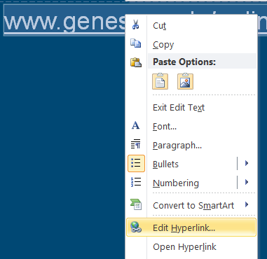

Readability: Hyperlinks
Hyperlinks need to make sense
  Online Learning is descriptive, www.genesee.edu/online isn’t too bad and Ok if being printed, but Click Here is not good.
To edit the hyperlink:
  Select the hyperlink
  Right-click
  Select Edit Hyperlink…
  Update the Text to Display field
  Click OK

Slide 18
Hyperlinks Best Practices
If there is a hyperlink in your material, remember to:
  Be descriptive with Naming (Text to display: field)
    Previous slide illustrates how to edit hyperlinks
  Keep hyperlinks the same blue and underlined
Notes:
Hyperlink blue is R: 0, G: 0, B: 255

Slide 19
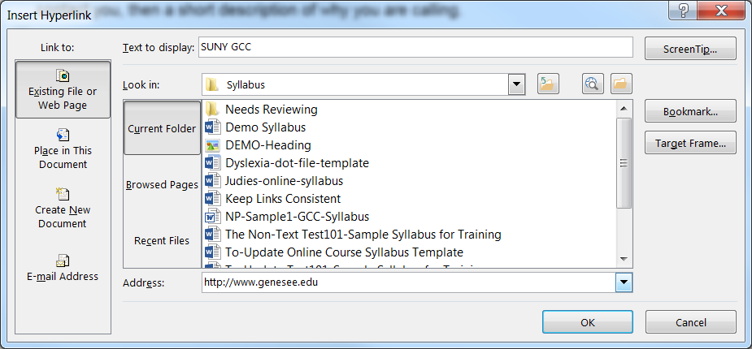
Stop and Do: http:// Hyperlinks
Find http:// in your Syllabus
  Select the hyperlink, right-click, Select Edit Hyperlink…, remove ‘http://’ from Text to display: field or update to descriptive words, and Click OK
Note: Since a Syllabus is printed, keeping the URL is necessary.

Slide 20

Readability: Images and Alternate Text
If it isn’t text, it isn’t readable by assistive technologies.
Do not use an image of text, unless:
  Add alternate text or mark as decorative (if it is)
3 Ways to Provide Alternate Text
Preceding Text
    Text leading up to non-text item (image, etc.)
Caption
    Underneath images
    Above charts and tables
Alt Text command
    Select non-text item > Right Click > Select Format [picture | table | chart]
Figure 1: GCC Mascot
(Caption example)
Notes:
Self-explanatory, alternate text is a text alternative for a non-text item, such as an image, art (clip art, smart art), chart, table, etc.
See link for presentation ju
Further Instruction: Visit Online Learning Faculty Resources to view Adding Alternate Text to Microsoft Documents for Accessibility (pptx, 1.3MB)
st on adding Alternate Text.

Slide 21
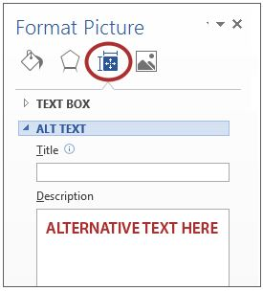
Stop and Do: Images and Alternate Text
Select an image (or table) in your Syllabus
  No image or table:
    From www.genesee.edu, right-click on the ‘CLASS SCHEDULE’ button, select Copy Image, and paste it into your document
Right-click on the image (or table) and select Format Picture… (or Table Properties)
Select the Layout and Properties icon
Select ALT TEXT
Add text in the Description (not Title) field
Delete the image if you don’t want it in your file.

Slide 22
Best Practices for Usability
For usability:
  Provide multiple formats

Slide 23
Usability: Provide Multiple Formats
Add multiple file types for attached documents
  Allows students using assistive technologies to choose
    .pdf is best for displaying a file on-line. Text based pdf can be used with text-to-speech software.
    .doc or .docx is used with text-to-speech software or braille display
    .rtf is best for those with vision loss or using a braille display
    Text is necessary for someone with dyslexia, has a visual impairment or learning disability to easily change the font, font size, contrast, etc. for their specific needs.
  Pdf and the original format is always a good choice
Notes:
Pdf is a good file type choice. Either have the original document format available upon request or simply add it as an alternative.
Instructors are surprised (usually pleasantly) at student creativity when allowed to express it in the format of their choice.

Slide 24
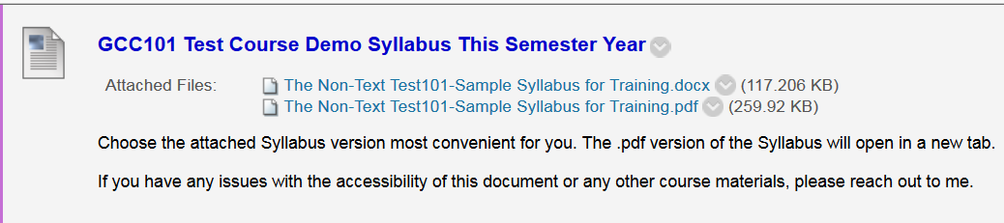
Usability: Provide Multiple Formats Example
Pdf and the original format is always a good choice
Notes:
Pdf is a good file type choice. Either have the original document format available upon request or simply add it as an alternative.

Slide 25
Best Practices for Navigability
For Navigability:
Use Heading Styles to populate the Navigation Pane
  Students can easily get to Top of Page or navigate to sections of the Syllabus (or document).
  Alleviate the scrolling or searching through a multi-page Syllabus especially for those who have issues using or cannot use a mouse
  Bonus: helpful to the author when editing sections such as changing dates for a new semester!

Slide 26
Headings (Styles)
Use the built-in styles (Heading 1, Heading 2, Heading 3, etc.)
  The navigation pane is populated
    Used for navigation by students, especially for those using assistive technologies or difficulty using a mouse.
  Must use Heading 1 Style
    This is used to get back to the beginning (top of document) quickly
  Must be unique and descriptive
  Must for longer documents to navigate (skip) around.
  Creates formatting consistency throughout your documents.
    Indents and spacing are the same for all of the same headings or styles used.
    Change the Style format, change all places using that Style
Notes:
Headings must be unique. If headings are the same, how does someone hearing the heading know if that’s where they need to be.
It is possible to modify different styles to be able to populate the Navigation Pane, but the default heading styles are set to do it as a standard.

Slide 27
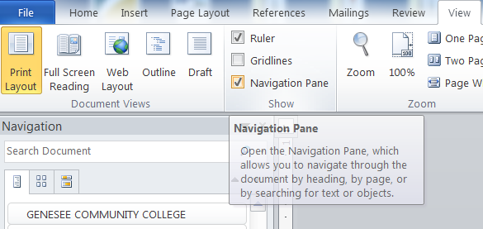
Stop and Do: Heading Styles
Open the Navigation Pane
  From the ‘View’ tab
  Select ‘Navigation Pane’ in the Show section

Slide 28
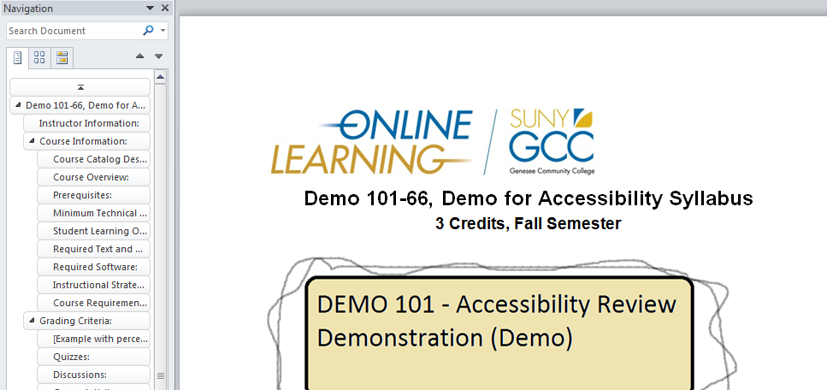
Heading Styles Example
Nothing there? Fix it by using Heading Styles.
Do you see blanks? Fix it by using Styles.
Heading 1
Heading 2
Heading 3
Note: The Online Learning logo is in the Header section. If it wasn’t, that would be Heading 1

Slide 29
Syllabus Must-Have: Accessibility Statement
For accessibility, the Syllabus must have an Accessibility Statement.
The following is the latest GCC Accessibility Statement you can use for your Syllabus:
  Accessibility Statement
  If you have a physical, psychological, medical or learning disability that may impact your coursework or participation in this class, please contact the Assistant Dean of Student Services/Disabilities Coordinator, Success Coach, or Academic Advisor who will arrange an intake meeting. The Assistant Dean/Coordinator will determine with you what accommodations are necessary, appropriate and reasonable. All information and documentation is confidential.
Notes:
Repeat: Put the Accessibility (Accommodations) Statement in multiple places:
Introductory Letter or Introduction Statement
Syllabus
On Blackboard

Slide 30
Stop and Do: Accessibility Statement
With the Navigation Pane open, find your Accessibility Statement or GCC Accommodations Statement
Missing?
  Add it with an appropriate Heading Style to populate the Navigation Pane

Slide 31
Accessibility Mantra
Making it accessible for those with disabilities makes it accessible for all!

Slide 32
Questions?

Slide 33

Feedback Is Appreciated
Thank You!
Notes:
Feedback forms are available to fill out or send comments to GCConline@genesee.edu

