Slide 1
Accessibility Doesn’t Mean “Boring”: Adding Color to Documents
By Nancy Pabros, Educational Technologist

Slide 2
Color Can Be Accessible
Adding color to documents is possible as long as you keep accessibility in mind.
Accessibility doesn’t have to mean eliminate the color and make it “Boring”
This slide, for example, with the dark blue background with white text and Online Learning Yellow Heading text is accessible.
Notes:
The Heading for this slide is Georgia 40 pt font
Text is Arial 28 pt white font

Slide 3
Making Documents Accessible: Accessibility “Top 10” Course Material List Quick Review
Link to Accessibility Statement
Keep Content Simple
Use Headings (Styles)
Use Color and Contrast Thoughtfully
Review Accessibility Checker Suggestions
Audio & Video Need Transcripts or Captioning
Hyperlinks Need to Make Sense
Provide Alternate Text
The More Ways the Better!
Consistency, Consistency, Consistency…
Notes:
Accessibility Self-Review Checklist (www.genesee.edu/cms/home/assets/File/Accessibility%20Self%20Review%20Checklist.docx) to show:
Accessibility Statement
Keep Content Simple
Headings (https://www.genesee.edu/cms/home/assets/File/Setting%20Defaults%20in%20Microsoft%20Word%20for%20Accessibility.pptx)
Color and Contrast
Accessibility Checker
Audio Transcripts and Video Captioning
Hyperlinks
Alternate Text (https://www.genesee.edu/cms/home/assets/File/Adding%20Alternate%20Text%20to%20Microsoft%20Documents%20for%20Accessibility%20-%20PAD.pptx)
The More Ways the Better!
Be Consistent

Slide 4
Making Documents Accessible: Color and Contrast
Link to Accessibility Statement
Keep Content Simple
Use Headings (Styles)
Use Color and Contrast Thoughtfully
Review Accessibility Checker Suggestions
Audio & Video Need Transcripts or Captioning
Hyperlinks Need to Make Sense
Provide Alternate Text
The More Ways the Better!
Consistency, Consistency, Consistency…

Slide 5
Keeping Accessibility in Mind with Color
Best Practices with Color that will be discussed are:
High contrast
Be respectful of white space
Do not use color as the only designator
Not sure, turn it to grayscale (print in black and white) to be sure
Be aware of visual disabilities that might not be disclosed:
Color Blindness
Use of Reading Glasses
Notes:
This is the agenda for the presentation

Slide 6
High Contrast: Black and White
Black text on a white background
White text on a black background
Preferred for people with certain vision impairments
This example is using the same font, font size, and text box size
Black on White
White on Black
Which do you prefer? They are both accessible.
Being accessible isn’t one way is the only way.
Notes:
Font used: Bolded Arial 44 pt
Both look crisp and easy to read because of the high contrast, but I think the white text on the right looks bigger (or bolder) than the black text.

Slide 7
The Good, the Bad, and the Ugly Contrast
Very High Contrast: Awesome
High Contrast: Good
Low Contrast: Bad
Very Low Contrast: Ugly
Very High Contrast
High Contrast
Low Contrast
Very Low Contrast
Notes:
Font used: Banschrift 36 pt

Slide 8


Good Contrast
Let’s start with Good Contrast
Microsoft.com examples:
Dark text, light background Light text, dark background
More Examples:
Good
Good
Good
Good

Slide 9
Good Contrast for Paragraph
This whole presentation shows good contrast for paragraphs, but how small can the font go and still have good contrast???
Arial 28 pt font
Arial 24 pt font
Arial 20 pt font
For Word documents 12 pt font is a general guideline for the smallest font to use for readability.

Slide 10
Not All Fonts are the Same
General guideline is 20 pt font is the smallest to be accessible, but which font:
This font is Arial 20 pt (sans serif font best for online reading and general use)
This font is Aharoni 20 pt
This font is Centaur 20 pt
This font is Chapparral Pro Light 20 pt
This font is KaiTi 20 pt
This font is Lucida San Unicode 20 pt
This font is Perpetua 20 pt
This font is Times New Roman 20 pt (serif font good when something is to be printed)
This font is Wide Latin 20 pt
Back to Arial and just shows that it is a guideline and the font used must be taken into consideration too.

Slide 11
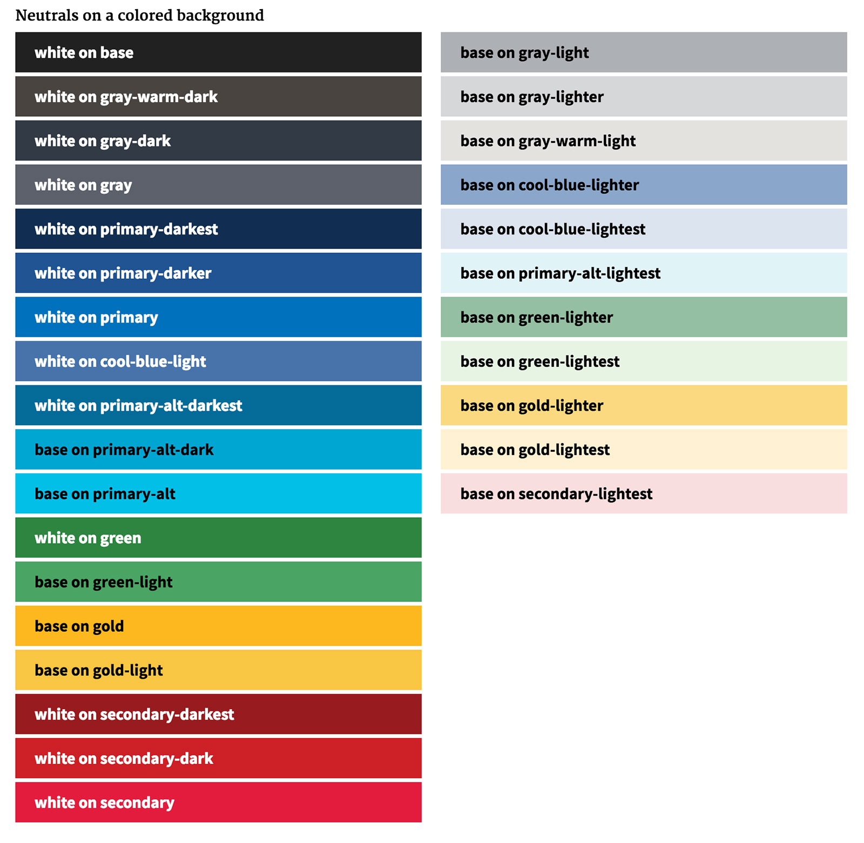
Good Contrast with White or Black Text
This chart shows foreground and background colors that pass color contrast checker
You don’t have to guess what has good contrast
If your unsure, who are you going call?
No, not me! Ok, fine, call me, but you can use a color checker just like I would.

Slide 12
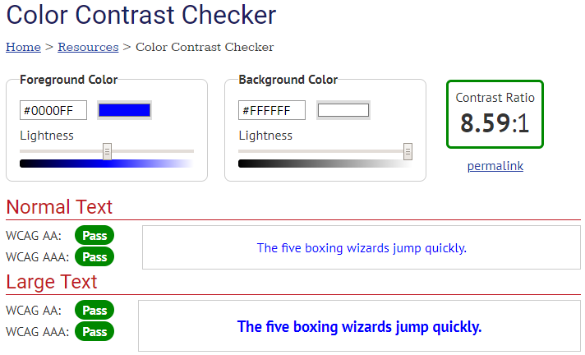
One Color Contrast Checker
WebAIM (Web Accessibility in Mind) Color Contrast Checker
Enter the hexadecimal color code or use the color picker tool for foreground and background
Result shows contrast ratio and if it will Pass WCAG 2.0 standards
Notes:
https://webaim.org/resources/contrastchecker/

Slide 13
WCAG 2.0
WCAG is Web Content Accessibility Guidelines
The AA Standards are what GCC needs to adhere to when creating content
Find more on WCAG 2.0 at: https://www.w3.org/TR/WCAG20/

Slide 14



Bad Contrast
Some Microsoft.com bad contrast examples:
Background blends in with the words = hard to read some letters
Dark text, dark background = hard to read
Light shadowed text, light background = also hard to read
General guideline is to avoid Text Effects (Shadow, Reflection, Glow, etc.)
Ok for Titles and Headings when larger font sizes are used, but avoiding is best
If you really, really want to embellish the font, try outline only and keep that to one word or short phrases, such as Titles and Headings
Notes:
Background blends in with the words = no-no
Dark text, dark background = yeah… not accessible
Light shadowed text, lighter background = also not accessible

Slide 15
Bad Contrast Updated
Keep the basic rules in mind:
dark text, use light background
light text, use dark background
Low contrast: Bad possible fixes
Poor Contrast
Same Text Color
Low Contrast
Good Contrast
Same Background Color
Same Text Color (Bolded)
Good Contrast
Good Contrast
Notes:
Poor contrast: Banschrift 36 purple text, Gray 50% Accent 5 background
Same Background Color: Banschrift 36 white text, Gray 50% Accent 5 background
Same Text Color: Banschrift 36 purple text, Light Green background
Same Text Color (Bolded): Banschrift 36 purple bolded text, Light Yellow background

Slide 16
Bad Contrast Updated continued
What to do for the middle (kind of dark or kind of light) colors? You can still create high contrast.
For example, this orange isn’t very dark or very light.
Poor Contrast
Same Background Color
Same Text Color
??????
GOOD
GOOD
??????
GOOD
GOOD
Outline Text is not always the best choice for accessibility – Use only with larger fonts (such as one word or short phrase Titles or Headings)
Notes:
Top Row:
1st GOOD (red background, same ??? yellow text outlined in black) Century Schoolbook 60 pt
2nd GOOD (same ???? light red background, white text outlined in black) Arial Unicode MS 60 pt
Bottom Row:
1st GOOD (same ???? light yellow background with Blue text) Century Schoolbook 60 pt
2nd GOOD (white background with same ??? grey text outlined in dark gray) Meiryo UI 60 pt

Slide 17
The Ugly Contrast Updated
Remember the very low (ugly) contrast from before:
Possible fixes are:
Same Background Color
Very Low Contrast
Same Font Color
Another Option
Another Option 2
Notes:
Very low contrast font Centaur 44 pt in Light Green with Lime background
Possible Fixes:
Same Background Color: Calibiri 40 pt Dark Blue
Same Font Color: Calisto 44 pt Light Green with Black background
Another Option: Centaur 60 pt Green bold font with White Background outlined in green
Another Option 2: Gadugi 44 pt Green bold font with Blue Background

Slide 18


More Ugly Contrast
Busy and distracting background and words close to one of the background colors = very low contrast and difficult or impossible to read
Can you read me?
Very low contrast
Extremely low contrast at the end of the sentence
CAN YOU READ ME?

Slide 19
Accessible Busy Background
Psychedelic backgrounds can be appropriate and these are examples of how to use them accessibly.
Can you read me now?
Can you read me now?
Notes:
1st example: Arial 40 pt
2nd example: Lucida Bright 38 pt

Slide 20
Accessible Busy Background continued
Previously the end of the sentence disappeared
Much better contrast, but still low contrast at the end
CAN YOU READ ME?
Even better contrast with Arial 48 pt font in white and black
CAN YOU READ ME?
Notes:
Use Color and Contrast Thoughtfully

Slide 21
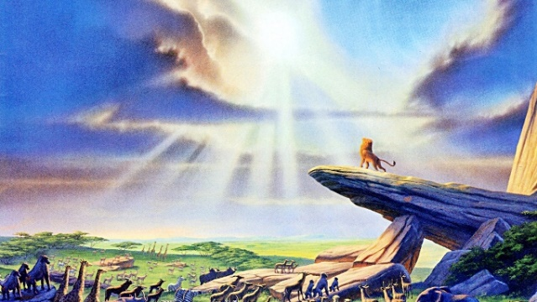

Image with Text Examples
Another ugly contrast examples:
Ugly Contrast!
Possible fixes from lots of choices
Can you name this movie?
Can you name this movie?

Slide 22
Be Respectful of White Space
Give white space all the
R E S P E C T
it deserves!

Slide 23
Disrespecting the White Space: Things You Can Do But Turns Out to Be What Not To Do!
Just because I can expand this text box to the very edges doesn’t mean it is such a great idea to do and remove the white space we know should be there.
Just because I can use a busy background image expanding behind all of the text, doesn’t mean it is such a great idea.
Notes:
When you need to expand a text box to fit the content should make you think about not doing it. Change the content, split into 2 slides (for presentations), etc.
Pick a font, font size, color, and effect, make sure it’s accessible, then continue with that and with only one or two others.

Slide 24
Respecting the White Space with borders
Use color accessibly by keeping layouts and margins respectful of white space.
Use busy patterns as a border, not a background
This adds lots of color, but words are still readable
Do the same to a Word document, but anchored correctly
Notes:
Keep the layouts as designed
Another accessible tip: This Heading details what the slide is in one line (use 2 at the most). When the Heading is too long, shorten the slide Title
Borders in Word documents should not be floating, but anchored to text so you are respectful of white space.

Slide 25

If Using Texture, Keep it Subtle
If a background is desired or necessary, keep it a subtle pattern or texture
Remember the bad background example:
Black text and a subtle pattern background.
Another Example with Gradient Fill
Another Example with Texture Fill
Notes:
Black text and a subtle pattern: Arial 36 pt Black text on Dotted Light Yellow Diamond pattern Background with Dark Blue – Accent 3, 80% lighter dots
Another Example with Texture Fill: Arial 36 pt Dark Blue (text 1), Newsprint Texture with Lucida Bright 44 pt bold black text
Another Example with Gradient Fill: Lucinda Bright 44 pt Black Text, Dark Blue Text 1 Lighter 80% Arial 36 pt bolded text

Slide 26
Do Not Use Color as the Only Designator
Using color as the only designator omits those with blindness, visual impairments, or using a screen reader or other assistive technology from understanding the content.
Best Practices:
Have at least 2 pieces of information to work with
Add actual labels in the diagrams, graphs, charts, etc.
Combine color with texture or a pattern
Try printing in black and white (or grayscale)
Does it still convey the same meaning?

Slide 27
Color as the Only Designator Forms
Stating “Highlighted fields are required”, is helpful for those who cannot see the highlight, such as someone who is blind and using a screen reader?
How to fix:
Add another designator along with yellow highlighted text
* is used with legend stating “* required fields” or “required fields are indicated with *”
Adding ‘(required)’ works too:
Last Name (required):

Slide 28
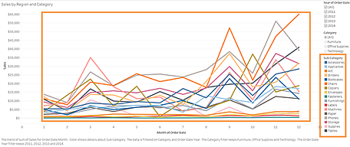
Color and Contrast Chart Bad Example
This chart uses only color to distinguish the lines from one another

Slide 29
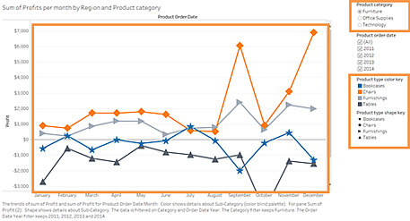
Color and Contrast Chart Good Example
Color and shapes add to the lines differentiates one from another

Slide 30
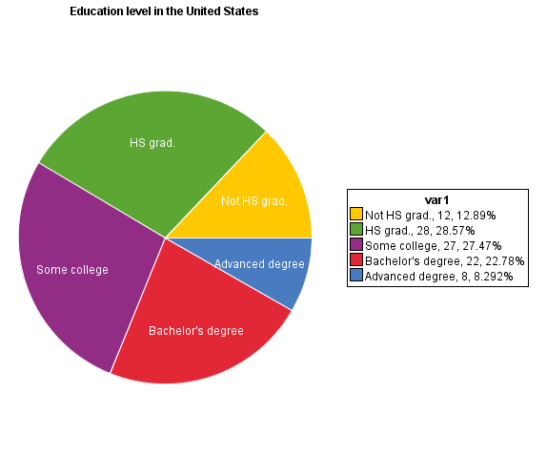
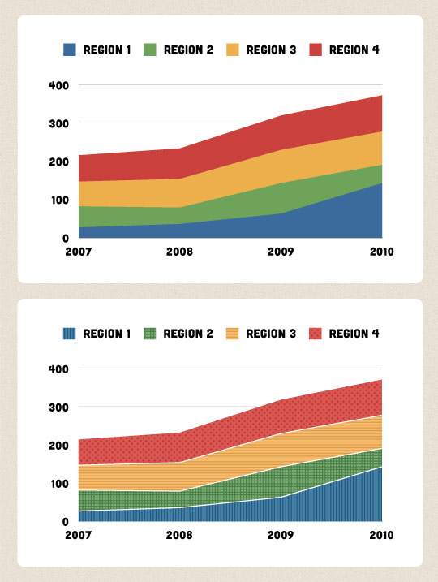
More Charts Examples
Accessible Chart using color and text along with a legend
Chart is fixed using color and pattern so color isn’t the only designator

Slide 31
Make it Black and White
Fact: Black and white is high contrast
Not sure about your color combinations, turn it to black and white (gray scale).

Slide 32
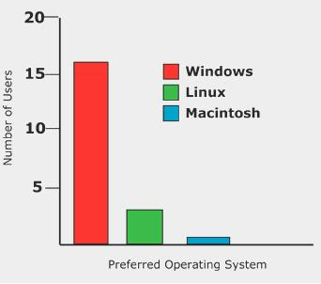
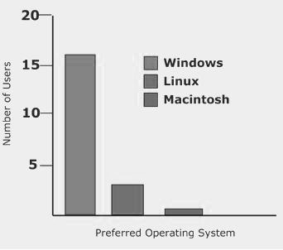
Charts: Not Accessible Example
Color is used as the only designator
In gray scale the chart is meaningless

Slide 33
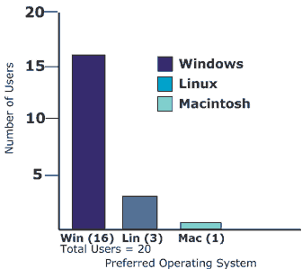
Charts: Accessible Example
The same chart made accessible.
Color is used, but not only way to determine what the chart is about
Columns are labeled at the bottom.

Slide 34





Some Accessible Signage
Classic-style OSHA signage
Color is meaningful but words and caution symbol also used so the sign in black and white is also meaningful

Slide 35
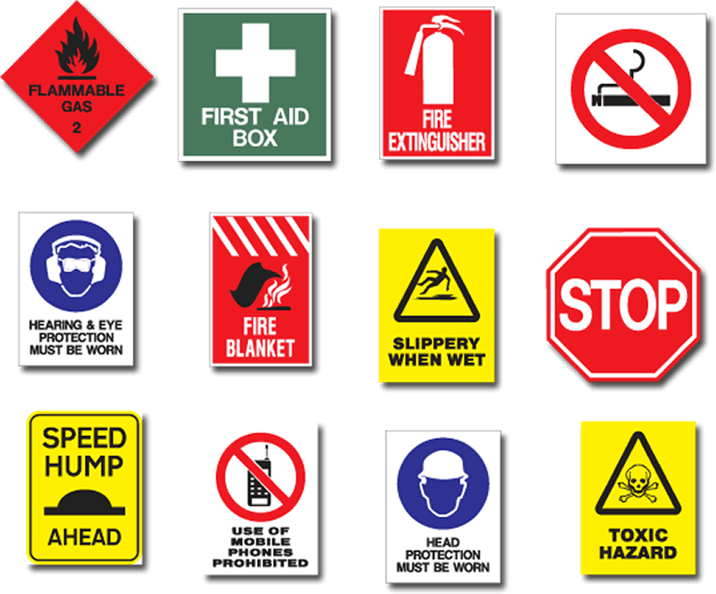


More Accessible Signage
Health and Safety pictures
Color is used, but not as the only designator
All of these signs have good contrast
Stop sign in black and white also has shape and words when color isn’t available.

Slide 36
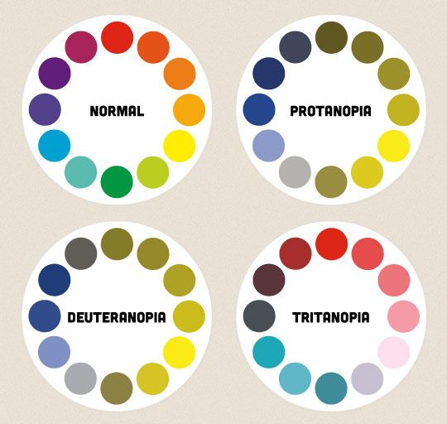
Color Blindness
This is an example of what the color looks like for the common types of color blindness
Using color as the only designator may not convey what you intend

Slide 37
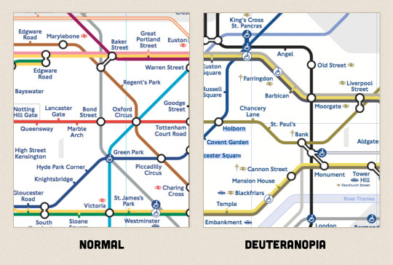
Not Accessible Subway Map
This subway map example to the right shows what one type of color blindness would see
“Take the Red line” would be meaningless

Slide 38
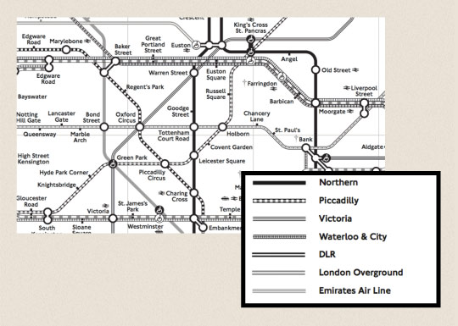
Subway Map Accessible Version
The color can remain, but cannot be the only designator
The previous map printed in black and white would not be readable at all
The subway map has been updated with patterns for each line
2 copies aren’t needed, just one copy with color and patterns

Slide 39
In Summary: Reading Glasses Consideration
Making it accessible for those with disabilities makes it accessible for all!
Include all people means include ME too because I wear reading glasses. To help me and everyone with disabilities:
Use color in high contrast
Respect white space needed to help those with visual impairments
Do not use color as the only designator
Check what the color looks like in gray scale or printed in black and white

Slide 40
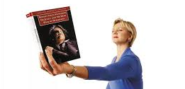
Forgot My Reading Glasses
Otherwise, this is what I look like when I forget my reading glasses!

Slide 41
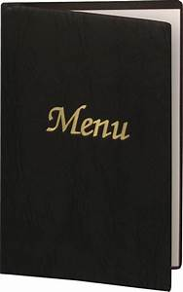



Forgot My Reading Glasses continued
What I look like at a restaurant when I forget my reading glasses!

Slide 42
Questions?
Notes:
I’m also available for any accessibility questions.
Nancy Pabros, nlpabros@genesee.edu, x6112
This presentation ca be found at http://www.genesee.edu/home/offices/online/faculty-resources/, our Faculty Resources section of the Online Learning web page.
Please note the YouTube videos produced by Online Learning are also available for alternate text and other accessibility features.

Slide 43

Feedback Is Appreciated
Thank You!
Notes:
Feedback forms are available to fill out or send comments to GCConline@genesee.edu

