Slide 1
Getting Started with Accessibility: Accessibility Checkers
By Nancy Pabros, Educational Technologist

Slide 2
Agenda
Accessibility “Top 10” Review
Accessibility Checker Instructions
Accessibility Checker Inspection Results
ERRORS
WARNINGS
TIPS
Manual Testing Checklist
Lab

Slide 3
Accessibility “Top 10” Course Material List Quick Review
Link to Accessibility Statement
Keep Content Simple
Use Headings (Styles)
Use Color and Contrast Thoughtfully
Review Accessibility Checker Suggestions
Audio & Video Need Transcripts or Captioning
Hyperlinks Need to Make Sense
Provide Alternate Text
The More Ways the Better!
Consistency, Consistency, Consistency…
Notes:
Accessibility Self-Review Checklist (www.genesee.edu/cms/home/assets/File/Accessibility%20Self%20Review%20Checklist.docx) to show:
Accessibility Statement
Keep Content Simple
Headings (https://www.genesee.edu/cms/home/assets/File/Setting%20Defaults%20in%20Microsoft%20Word%20for%20Accessibility.pptx)
Color and Contrast
Accessibility Checker
Audio Transcripts and Video Captioning
Hyperlinks
Alternate Text (https://www.genesee.edu/cms/home/assets/File/Adding%20Alternate%20Text%20to%20Microsoft%20Documents%20for%20Accessibility%20-%20PAD.pptx)
The More Ways the Better!
Be Consistent

Slide 4
Making Documents Accessible: Review Accessibility Checker Suggestions
Link to Accessibility Statement
Keep Content Simple
Use Headings (Styles)
Use Color and Contrast Thoughtfully
Review Accessibility Checker Suggestions
Audio & Video Need Transcripts or Captioning
Hyperlinks Need to Make Sense
Provide Alternate Text
The More Ways the Better!
Consistency, Consistency, Consistency…

Slide 5
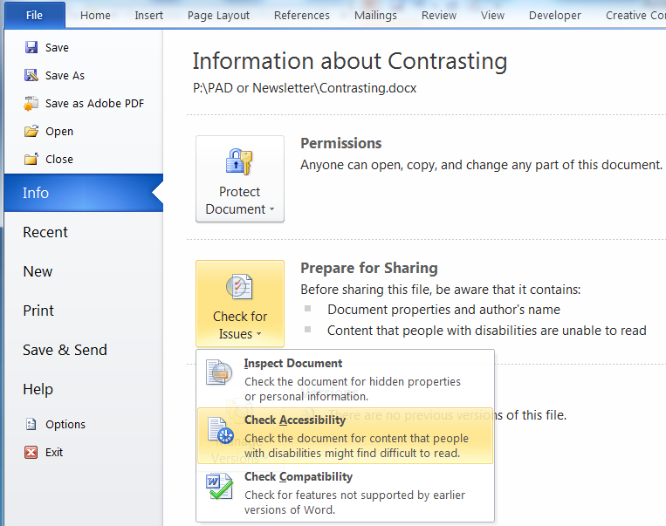
Microsoft Word Accessibility Checker Instructions
For Microsoft Word 2010 and 2013, select:
File
Info
Check for Issues
Check Accessibility

Slide 6
Stop and Do: Accessibility Checker Instructions
Open an existing Word document
Click File -> Info -> Check for Issues -> Check Accessibility

Slide 7
Review Accessibility Checker Suggestions
The checker presents accessibility errors, warnings, and tips along with why it should be fixed and instructions on how to fix them.
Notes:
Demo can be to show Accessibility Checker for this presentation.

Slide 8
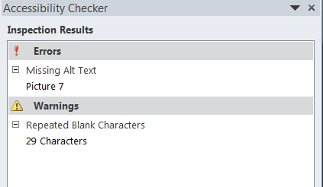
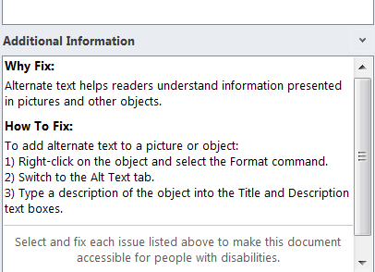
Accessibility Checker Inspection Results
Inspection Results show:
ERRORS
WARNINGS
TIPS
Select the Error, Warning, or Tip content:
Cursor will be placed at that spot
Additional Information will show specific to that Inspection Result
Additional Information shows:
Why Fix
How To Fix
When fixed they disappear from the list

Slide 9
Accessibility Checker Inspection Results: ERRORS
Inspection Result ERRORS:
Includes content that is very difficult or perhaps impossible for people with disabilities to understand.
Must be fixed for accessibility or determined to be addressed in another accessible way

Slide 10
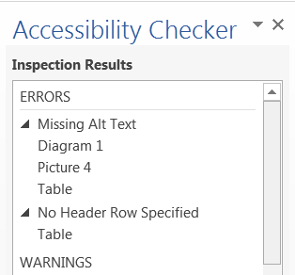
Accessibility Checker Inspection Results: ERRORS continued
Inspection Result ERRORS Include:
Missing Alt Text
For Diagrams, Pictures, Tables, etc.
No Header Row Specified
For tables

Slide 11
Accessibility Checker ERRORS: Missing Alt Text
Why Fix:
Alternate text helps readers understand information presented in pictures and other objects
Include alternate text with all visuals (pictures, clip art, Smart Art, graphics, shapes, groups, charts, embedded objects, ink, and videos)
How to Fix:
Right-click on the object, and click Format
Click Layout & Properties
Expand the Alt Text section
Type a description of the object into the Title and Description boxes
Notes:
Find

Slide 12
Accessibility Checker ERRORS: Missing Alt Text continued
Exception to the Rule:
When an image is decorative it doesn’t need alternate text.
A space can be added in the description field creating a ‘blank’ or ‘null’ alternate text
Notes:
Find

Slide 13
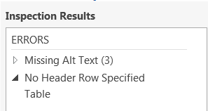
Accessibility Checker ERRORS: No Header Row Specified
Why Fix:
Column headings provide context and
aid navigation of the data in a table
When heading rows are not defined,
non-sighted users may have difficulty
identifying the meaning of data cells and
how they relate to other data in the table.
How to Fix:
Select the table and highlight the top header row(s)
Click on the Table Tools | Layout tab
Click Repeat Header Rows in the Data area

Slide 14
Accessibility Checker ERRORS: No Header Row Specified continued
Exceptions to the Rule:
The table doesn’t have (or really need) headings for the content to make sense or for readability.
The content can also be represented as:
Blue Things
Sky
Blueberries
My Car
Red Things
Some fruit
Stop signs
Blue Things | Sky Blueberries My car
Red Things | Some fruit Stop signs

Slide 15

Stop and Do: ERRORS Check and Fix
Fix ERRORS found in your document:
Missing Alt Text for Diagrams, Pictures, Table, etc.
No Header Row Specified for Tables
Note: Select and fix each issue listed above to make this document accessible for those with disabilities.

Slide 16
Accessibility Checker Inspection Results: WARNINGS
Inspection Result WARNINGS:
Includes content that is could be difficult for people with disabilities to understand.
Ideally these items should be fixed to strengthen your document for accessibility.

Slide 17
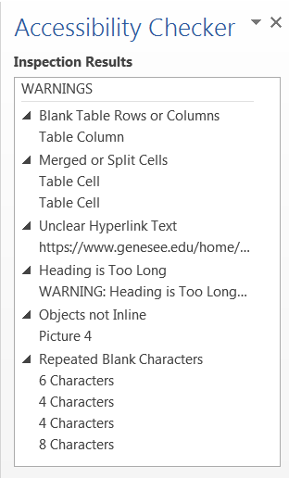
Accessibility Checker Inspection Results: WARNINGS continued
Inspection Result Warnings:
Must be fixed or acknowledged to be correct for accessibility
There are exceptions to rules
Includes:
Blank Table Rows or Columns
Merged or Split Cells
Unclear Hyperlink Text
Heading Too Long
Objects not Inline
Repeated Blank Characters

Slide 18
Accessibility Checker WARNINGS: Blank Table Rows or Columns
Best Practice:
All tables must not have blank rows or columns
Why Fix:
When tables contain blank rows or columns, it is difficult for non-sighted users to understand and navigate through the table.
Blank table cells can mislead a person with a vision disability into thinking there is nothing more in the table.

Slide 19
Accessibility Checker WARNINGS: Blank Table Rows or Columns continued
How to Fix:
Delete unnecessary blank cells.
OR If you table is only intended to layout content in your document, clear all table styles from your table.
To clear styles:
Select the entire table
Click on Table Tools | Design tab
Expand the Table Styles gallery and click Clear on the menu below the gallery

Slide 20
Accessibility Checker WARNINGS: Merged or Split Cells
Why Fix:
Tables should have simple two-dimensional structure for easier navigation and ability to be understood by people with disabilities
This WARNING will also appear when you nest tables (embed a table in a table cell)
How to Fix:
Click the cell that is split
On the Layout tab, click Merge Cells in the Merge area
Choose the proper merge criteria
OR
Click the cell that is merged and choose Split Cells in the Merge area

Slide 21
Accessibility Checker WARNINGS: Unclear Hyperlink Text
Best Practice:
Add meaningful hyperlink text and Screen tips
Why Fix:
Hyperlink text should provide a clear description of the link destination instead of providing only the URL

Slide 22
Accessibility Checker WARNINGS: Unclear Hyperlink Text Continued
How To Fix: To make the hyperlink text more accessible:
Select the link and click Hyperlink on the Insert tab to open the edit Hyperlink dialog.
Or select the words or entire hyperlink, right-click, and select Hyperlink…
Type a phrase in the Text to display: field which will briefly describe the link destination.
The Address: field is the URL address including http(s)://
Note: You can also click Screen Tip in the Edit Hyperlink dialog to add a meaningful description to the hyperlink. The Screen Tip text appears when your cursor hovers over text or images that include a hyperlink.
Exception to the rule:
When you expect the document to be printed, the link needs to be stated in its entirety

Slide 23
Accessibility Checker WARNINGS: Heading Too Long
Best Practice:
Headings need to be descriptive but not too long. Up to 2 lines is a good guideline with 1 line preferred.
Even though Heading Too Long is not a requirement, it is good to fix to strengthen your document for accessibility.
Why Fix:
Short, concise headings make it easier for people with disabilities to quickly navigate the document structure.
How to Fix:
Shorten long titles to concise words or short phrase. Add subsequent information to content under title.

Slide 24
Accessibility Checker WARNINGS: Repeated Blank Characters
Best Practice:
Use indent, tab stops, or built-in table function instead of space, space, space and tab, tab, tab to line up data.
Use paragraph and avoid using multiple carriage returns (Enters) to get paging
Why Fix:
Any extra “blanks” (spaces, tabs, and empty paragraphs) may be perceived as the end of the information.
Older screen readers may stop reading when multiple spaces are encountered

Slide 25
Accessibility Checker WARNINGS: Repeated Blank Characters continued
How To Fix:
Use formatting, indenting, and styles to create whitespace instead of repeating blank characters.
To use formatting to add whitespace around a paragraph:
Remove any existing whitespace around the paragraph
Select the text, then right-click and choose Paragraph.
Select values for Indentation and Spacing to create whitespace
To un-anchor an image that you added multiple carriage returns behind
Select the image, right-click, select Wrap Text, select ‘In Line with Text’

Slide 26
Stop and Do: WARNINGS Check and Fix
Fix WARNINGS in your document:
Blank Table Rows or Columns
Merged or Split Cells
Unclear Hyperlink Text
Heading Too Long
Objects not Inline
Repeated Blank Characters

Slide 27
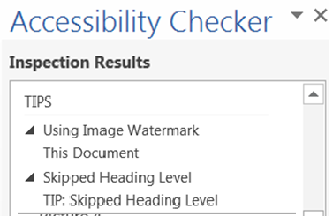
Accessibility Checker Inspection Results: TIPS
Inspection Result TIPS:
Includes:
Using Image Watermark
Skipped Heading Level

Slide 28
Accessibility Checker TIPS: Using Image Watermark
Why Fix:
Images used as watermarks may not be understood by people with vision or cognitive disabilities.
How to Fix:
Watermarks cannot be made accessible. Make sure the information included in the watermark is also included elsewhere in the document.

Slide 29
Accessibility Checker TIPS: Skipped Heading Level
Best Practice:
Check Navigation pane for readability
It can show if entire sections are missing (acts like an Index does)
Why Fix:
This Navigation Pane is used for navigability in a document
Using heading levels in logical order makes it easier for readers to find information and navigate the document.

Slide 30
Accessibility Checker TIPS: Skipped Heading Level continued
How to Fix:
Open the Navigation Pane (Click View tab and select Navigation Pane in the Show area)
Find skipped heading and change Style appropriately
Exception to the rule:
Does it make sense being skipped? If so, it is a TIP and just a suggestion to strengthen the document for accessibility.

Slide 31
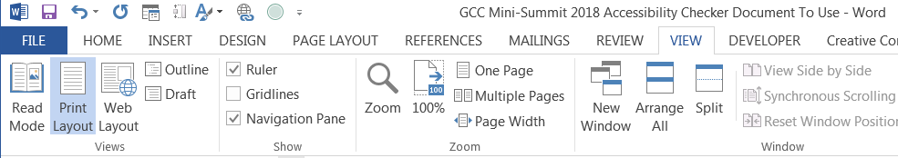
Stop and Do: TIPS Check and Fix
Open the Navigation Pane:
Click View
Select Navigation Pane in the Show area
Correct any Skipped Heading Levels

Slide 32
Manual Testing
The Accessibility Checker is a program and checks all of the previous items
Manual testing is still needed to ensure your documents are strengthened even more for accessibility

Slide 33
Manual Testing Checklist
Manual Testing Checklist includes:
List formatting
Language settings
Document properties
Color and contrast
Complex tables
Check if using unclear (for example: Click here) hyperlinks
Adding structure to documents using Headings and Styles
Blank table entries

Slide 34
Lab Time
Introducing Eric Scoles as our Lab Assistant!
If you do not already have a file open:
Log in and access your P:\ drive
Grab a file – any file – and run the Accessibility Checker
File -> Check for Issues -> Check Accessibility

Slide 35
Questions?
I’m also available for any accessibility questions.
Nancy Pabros, nlpabros@genesee.edu, x6112, T133
Notes:
I’m also available for any accessibility questions.
Nancy Pabros, nlpabros@genesee.edu, x6112
This presentation ca be found at http://www.genesee.edu/home/offices/online/faculty-resources/, our Faculty Resources section of the Online Learning web page.
Please note the YouTube videos produced by Online Learning are also available for alternate text and other accessibility features.

Slide 36

Feedback Is Appreciated
Thank You!
Notes:
Feedback forms are available to fill out or send comments to GCConline@genesee.edu

