Slide 1
Accessibility “Top 10” Fixes
By Nancy Pabros, Educational Technologist
Notes:
Preparation:
Have Blackboard sandbox available
Ensure links to Accessibility Self-Review Checklist and Online Learning Faculty Resources page are available (or open)
Accessibility Self-Review Checklist (www.genesee.edu/cms/home/assets/File/Accessibility%20Self%20Review%20Checklist.docx)
Online Learning Faculty Resources (http://www.genesee.edu/home/offices/online/faculty-resources/)

Slide 2
Accessibility “Top 10” Fixes Agenda
The Accessibility “Top 10” Fixes List
Overview of Each Fix
Questions?
The Top 10 Relisted: Demo?
Kiosk Demo

Slide 3
Agenda Topic 1
The Accessibility “Top 10” Fixes List

Slide 4
Accessibility “Top 10” Fixes, the First 5
Add the Accommodations Statement
Keep Content Simple
Use Headings (Styles)
Use Color and Contrast Thoughtfully
Review Accessibility Checker Suggestions
Notes:
Throughout this presentation, most of these “Top 10” were used when creating the slides.
This is not an exhaustive list.
#2 includes several fixes or tips

Slide 5
Accessibility “Top 10” Fixes, the Next 5
Audio & Video Need Transcripts or Captioning
Hyperlinks Need to Make Sense
Provide Alternate Text
The More Ways the Better!
Consistency, Consistency, Consistency…
Notes:
Again, not an exhaustive list
#9 and #10 includes several fixes or tips
Ask questions throughout
Stop if a demo is needed or wait until the end

Slide 6
To Fix or Not to Fix
Most of these fixes (or tips) are:
Easy to do
Some need a little instruction, training, or practice first
Take just a little bit of time
Are common sense
Can be used to strengthen your current course
Should always be used when creating new materials
Keep Accessibility In Mind
Notes:
Keep accessibility in mind, especially when creating new materials.

Slide 7
Agenda Topic 2
Overview of Each Fix
Notes:
This presentation gives an overview and leaves time at the end for questions and demos if needed.
They are an overview because some of the fixes in the list are an entire presentation itself.

Slide 8
1. Add the Accommodations Statement
Copy and paste the GCC Accommodations Statement
The more places the better. The more it is seen, the more chances it will be read.
The GCC Accommodations Statement:
If you have a physical, psychological, medical, or learning disability that may impact your coursework or participation in this course, please contact the Center for Academic Progress, D 208, 343-0055, extension 6351. The Assessment team will determine with you what accommodations are necessary, appropriate and reasonable. All information and documentation is confidential.
Notes:
Easy to do! Copy and paste the GCC Accommodations Statement, the more places the better to be seen and read.
Used interchangeably as Accessibility Statement.

Slide 9
Accessibility Statement Best Practices
Put the Accessibility Statement in multiple places:
Introductory Letter or Introduction Statement
Syllabus
On Blackboard
This allows students with disabilities to know where to go
“. . . between 60-80% of students with disabilities in Higher Education institutions choose not to disclose their disability to their college or university”
Notes:
Excerpt from Blackboard Blog 5 key accessibility trends in North American education (http://blog.blackboard.com/5-key-accessibility-trends-north-american-education/)

Slide 10
2. Keep Content Simple
Keep content simple and avoid:
Someone missing content
Confusion for those with learning disabilities or where English is a second language
Emphasis:
Use italics and bold for emphasis of a word, short phrase, or titles.
Entire paragraphs that are italicized can make for a more difficult reading. This could be especially true for those with dyslexia, learning disabilities, or vision difficulties. Keeping text simple and using one or two ways to create emphasis will make your content accessible to all students regardless of disabilities or not.
Notes:
Avoid someone missing content especially because of formatting

Slide 11
Keep Content Simple Continued 1
Keep content simple and:
Avoid slang and idioms
Write out acronyms the first time they are used
Use left-aligned text as a guideline
Exceptions:
When the language is correct with right (for example: Hebrew) or centered-aligned (for example: newspaper columns) text
Headings can be centered, page numbers can be right-aligned, etc.
Someone using a screen magnifier might miss content if alignment or spacing is not as expected.
Notes:
Merriam-Webster definitions:
Slang : words that are not considered part of the standard vocabulary of a language and that are used very informally in speech especially by a particular group of people
Idiom : an expression that cannot be understood from the meanings of its separate words but that has a separate meaning of its own
: a form of a language that is spoken in a particular area and that uses some of its own words, grammar, and pronunciations
: a style or form of expression that is characteristic of a particular person, type of art, etc.

Slide 12
Keep Content Simple Continued 2
Fonts:
Choose simple sans-serif (without tail) fonts for reading on-line.
Arial, Calibri, Tahoma, and others
A serif font, such as Times New Roman is fine for documents expected to be printed
Choose one or two fonts and stick with those.
Too many font choices makes for a more difficult read!
Unless, of course, it’s for a ransom note!!!!
Notes:
Stick to San-serif fonts for everything.
Serif fonts for thing to be printed, such as a resume is fine.

Slide 13
Keep Content Simple Continued 3
Keep content simple and:
Review need for Roman Numerals
Screen readers read III as ‘eye eye eye’ and XIV as ‘ziv’
Avoid flashing, rapidly changing, or alternating images
The flashing can cause seizures. Avoid to prevent or ensure at a low rate, sensitivity under 3 hertz (flashes per second) is not common.
For presentations like Microsoft PowerPoint, use a single type of transition or no transition
Notes:
What rate of flashing light can trigger seizures?
Between 3-30 hertz (flashes per second) are the common rates to trigger seizures but this varies from person to person. While some people are sensitive at frequencies up to 60 hertz, sensitivity under 3 hertz is not common. (from: https://www.epilepsysociety.org.uk/photosensitive-epilepsy)

Slide 14
3. Use Headings (Styles)
Use the built-in styles (Heading 1, Heading 2, Heading 3)
The navigation pane is populated
Used for navigation by students, especially for those using assistive technologies.
Must use Heading 1 Style
This is used to get back to the beginning (top of document) quickly
Must be unique and descriptive
Must for longer documents to navigate (skip) around.
Creates formatting consistency throughout your documents.
Indents and spacing are the same for all of the same headings or styles used.
Change Style format, change all places using that format
Notes:
Headings must be unique. If headings or slide titles are the same, how does someone hearing the heading or title know if that’s where they need to be.

Slide 15
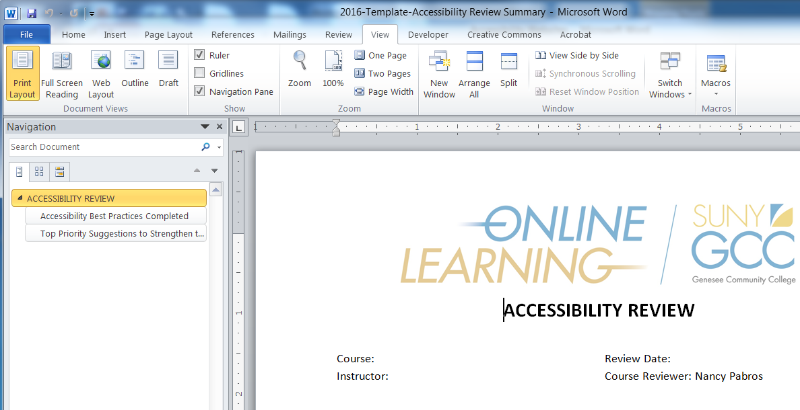
Heading Styles Example
To open Navigation:
View Tab > Click Navigation Pane box in Show section
Heading 1
Heading 2
Note: The Online Learning logo is in the Header section. If it wasn’t, that could be Heading 1 (or top of document).

Slide 16
Use All Built-In Features
While you are at it, use all of the built-in features Microsoft and other programs offer:
Styles
Headings are necessary, other Styles help maintain consistency
Bullets
Tables
Indent
Etc.
Keep slide Built-In Layouts for PowerPoint
Notes:
Keep formatting consistent and the best way to do that is consistently use the built-in features programs provide.
Use Bullet feature, don’t type in the numbers and spaces
Use Indent feature, don’t type spaces
If you are creating columns of information that have a heading, think about using a Table

Slide 17
4. Use Color and Contrast Thoughtfully
High contrast is needed
Black text on white background
White text on black background
Do not use color as the only designator
Does everything make sense when printed in black & white?
Be careful using color blindness combinations
Some examples are red/green, blue/purple combinations
Don’t eliminate all of the white space
Notes:
Next slides have examples

Slide 18






Good and Bad Contrast
Can you read me?

Slide 19

Things You Can Do But Turns Out to Be What Not To Do!
Just because I can expand this text box to the very edges, doesn’t mean it is such a great idea to do and remove the white space we know should be there.
Just because I can use a busy background image expanding behind all of the text, doesn’t mean it is such a great idea.
Just because I _{can} use a lot of colors and effects for text doesn’t mean it is such a ^{great} idea!.
Notes:
When you need to expand a text box to fit the content should make you think about not doing it. Change the content, split into 2 slides (for presentations), etc.
Pick a font, font size, color, and effect, make sure it’s accessible, then continue with that and with only one or two others.
Screen readers will ignore the strikethrough and read the word as if it didn’t have the strikethrough.

Slide 20
Accessibility Doesn’t Mean Boring
Use color accessibly
Use busy patterns as a border, not a background.
Can you read me now?
Colored fonts can create an accessible ombré effect!
Notes:
#4 is Use Color and Contrast Thoughtfully

Slide 21
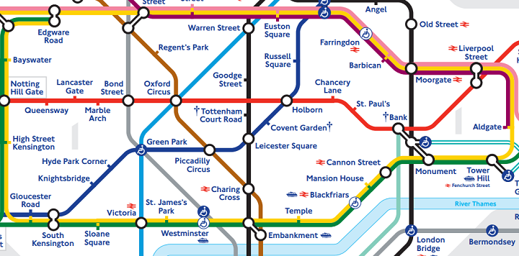
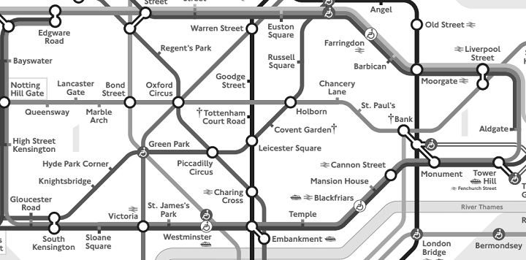
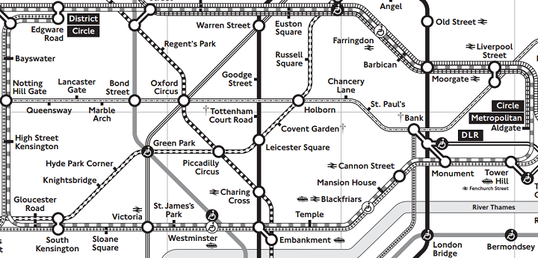
Accessibility for the ColorBlind
UK Colored Tube Map
Same UK Tube Map in Black and White
Accessible UK Tube Map

Slide 22
Accessible Blackboard Themes
Default is always a good choice!
Or choose an accessible theme from the categories
Category | Accessible Themes
Color | Citrus, Ink, Lavender, Sand, Steel, Sunshine
Design | Composition, Connected, Inspiration, Mosaic, Nature, Pine, Rainbow, Soccer
Season | Halloween, Spring, Summer
Structure | Angel, Open Source, Vista
Subject | Accounting, Astronomy, Chemistry, Digital Learning, Finance, History 1, Music 1
Notes:
Themes not listed are either borderline accessible meaning they had one little thing that was questionable or not accessible when the pattern covered up or blended into letters entirely making them hard to read.

Slide 23

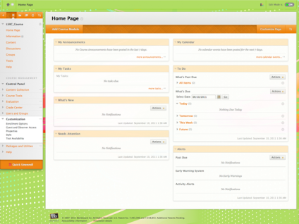
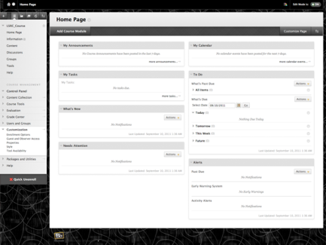
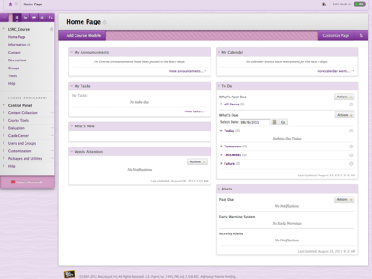
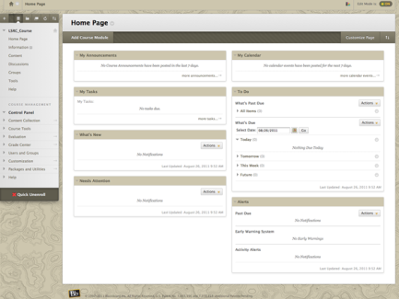
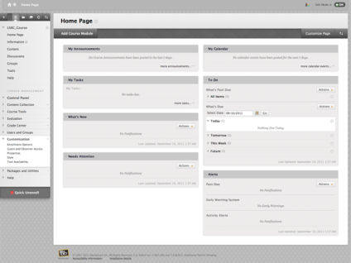
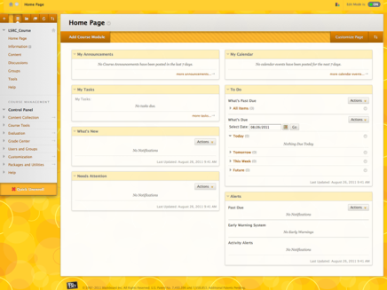
Accessible Blackboard Themes Default and Color Categories
Default
Under Color: Citrus, Ink, Lavender, Sand, Steel, Sunshine

Slide 24
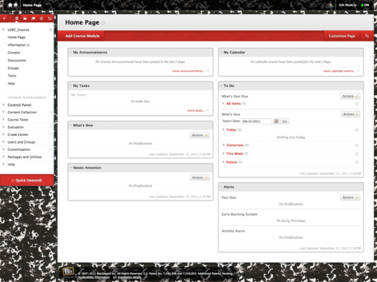
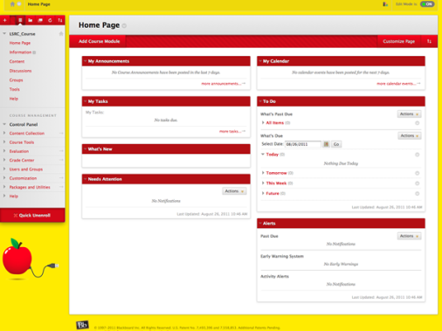
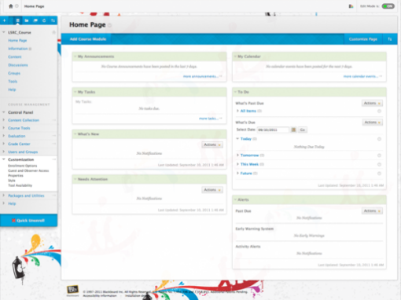
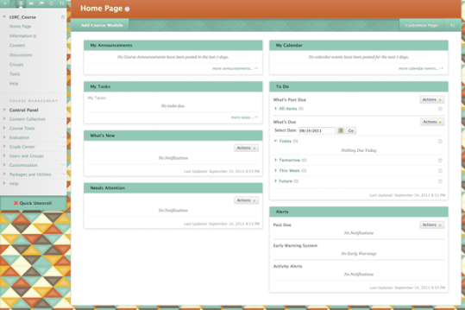
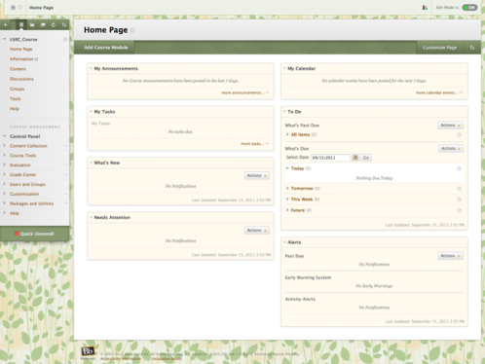
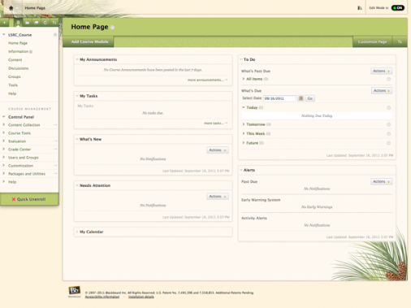
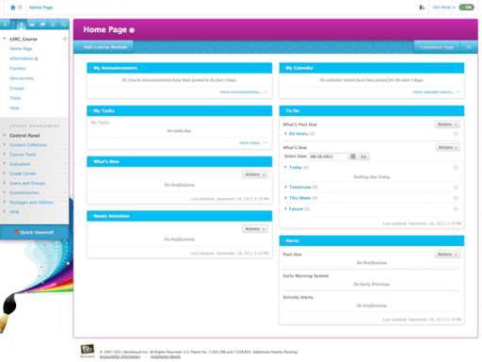
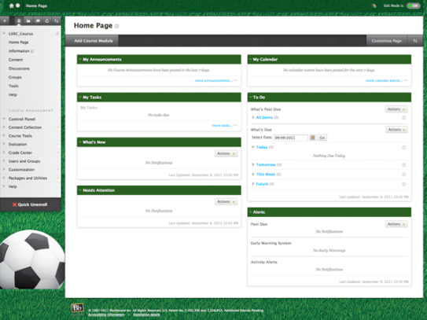
Accessible Blackboard Themes Design Category
Under Design: Composition, Connected, Inspiration, Mosaic, Nature, Pine, Rainbow, Soccer

Slide 25
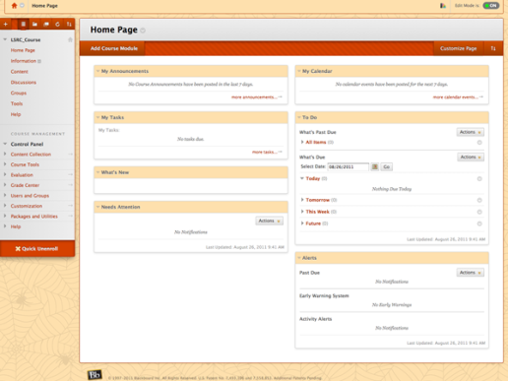
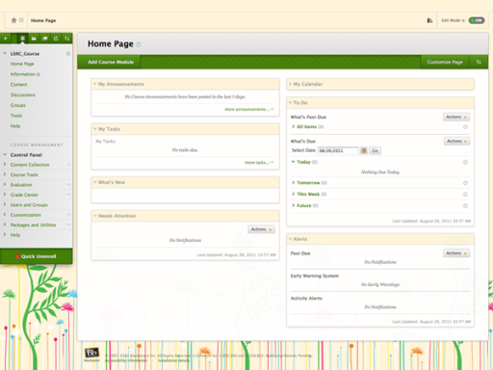
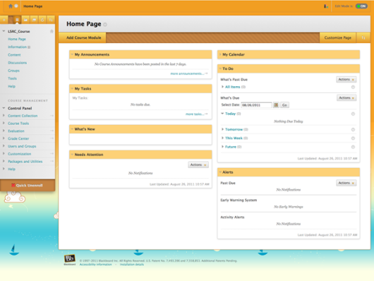
Accessible Blackboard Themes Season Category
Under Season: Halloween, Spring, Summer

Slide 26
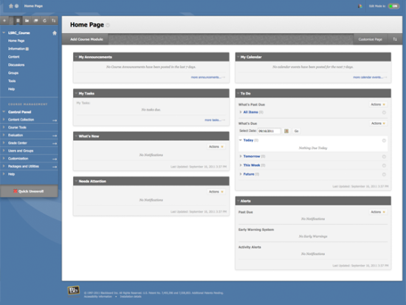
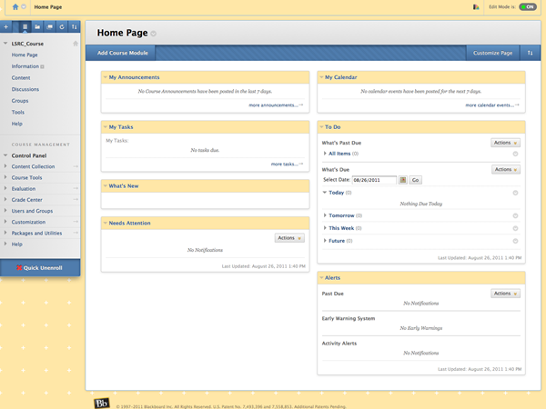
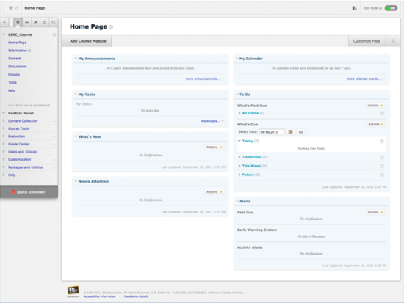
Accessible Blackboard Themes Structure Category
Under Structure: Angel, Open Source, Vista

Slide 27
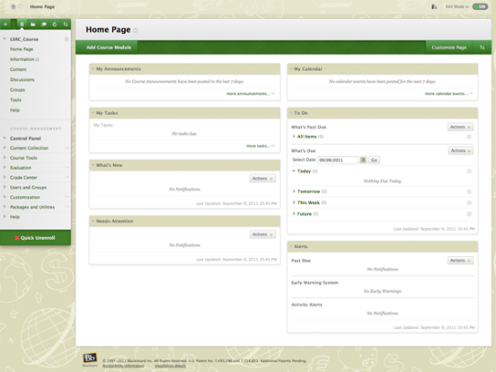
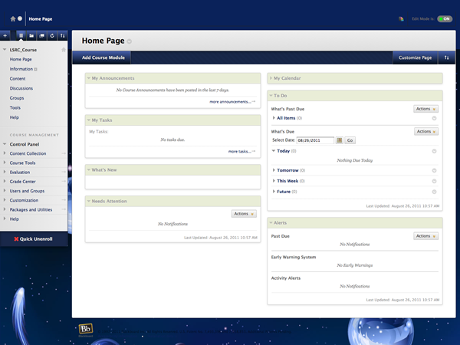
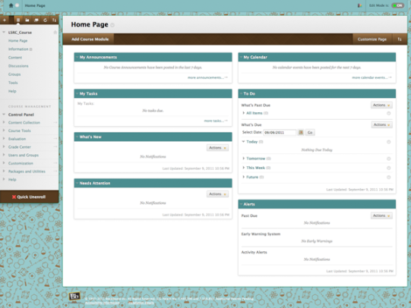
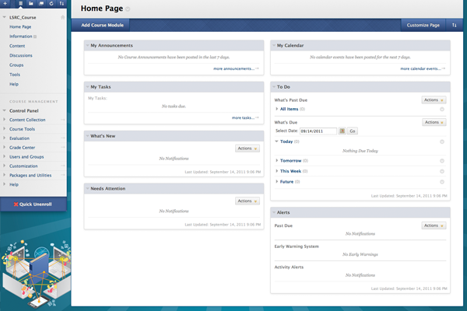
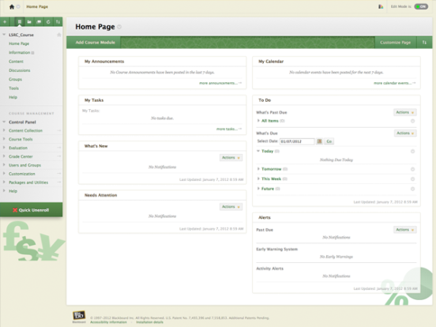
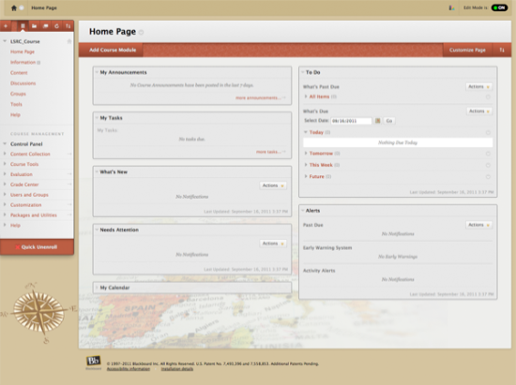
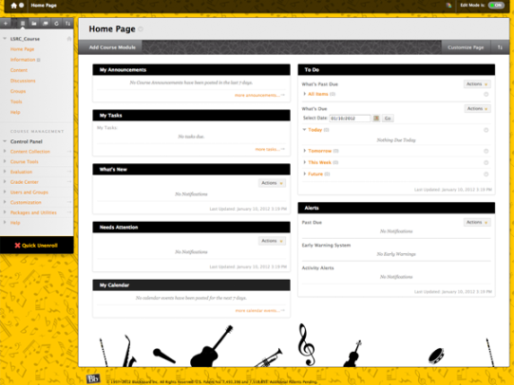
Accessible Blackboard Themes Structure Category
Under Subject: Accounting, Astronomy, Chemistry, Digital Learning, Finance, History 1, Music 1

Slide 28
5. Review Accessibility Checker Suggestions
Accessibility Checker Instructions:
Microsoft Word Accessibility Checker
Select File> Info> Check for Issues> Check Accessibility
Adobe Acrobat
Select Tools > Accessibility > Full Check
The checker presents accessibility errors, warnings, and tips on how to repair them.
Notes:
Demo can be to show Accessibility Checker for this presentation.

Slide 29
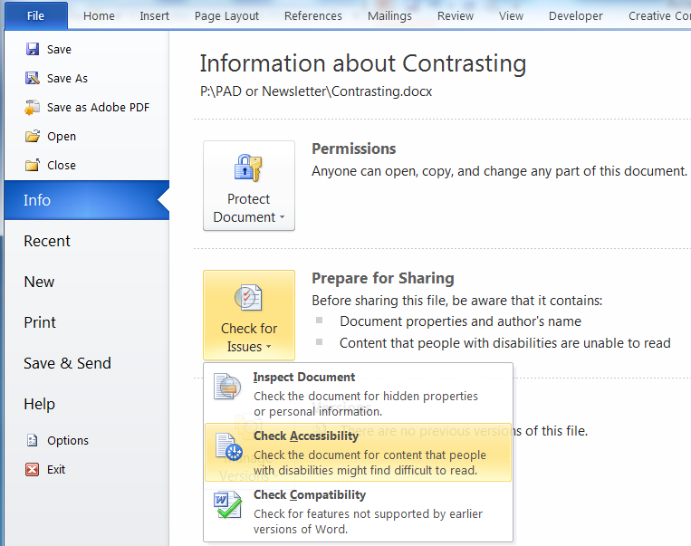
Microsoft Word Accessibility Checker
For Microsoft Word 2010: File > Info > Check for Issues > Check Accessibility

Slide 30
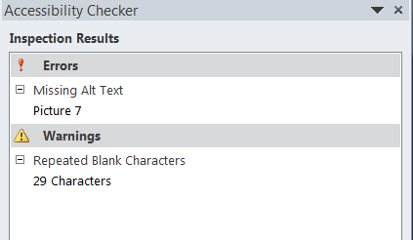
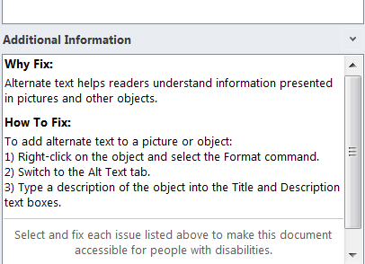
Accessibility Checker Inspection Results
Inspection Results show:
Errors
Warnings
Click on Error or Warning:
Cursor will be placed at that spot
Additional Information will show appropriately
Additional Information shows:
Why Fix:
How To Fix:
Demo Needed?
Notes:
Demo Anyone?
Intentional duplicate slide title for Slide 26 & 27 to show Tips Category
Errors category shows Missing Alt Text for this slide 30

Slide 31
6. Audio & Video Need Transcripts or Captioning
Those with hearing impairments benefit
Anyone working in noisy environments benefit
Helps people learn new terminology
Helps those where English is their second language
Can you come up with another reason???
Notes:
Others I can come up with where transcripts and captioning can help:
Listening to someone with an accent
Learning a new language

Slide 32
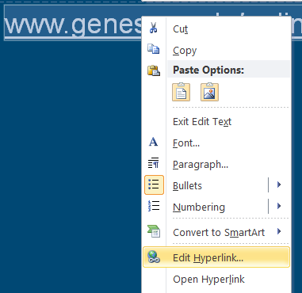

7. Hyperlinks Need to Make Sense
Hyperlinks need to make sense
Online Learning is descriptive, www.genesee.edu/online isn’t too bad, but Click Here is not good.
To edit the hyperlink:
Select the hyperlink
Right-click
Select Edit Hyperlink…
Update the Text to Display field
Click OK

Slide 33
Hyperlinks Best Practices
If there is a hyperlink in your material, remember to:
Be descriptive with Naming (Text to display: field)
Previous slide illustrates how to edit hyperlinks
Identify file type and size if link is non-web item
For example, HIS100-66-Syllabus (PDF, 30KB)
The more descriptive the better
Inform user if opening in a new window (or tab)
Why? Because you are navigating away from the main content and someone with a vision disability could have a problem returning to the starting point.
Offer link to software needed for non-web items
For example, Adobe Reader is needed to open PDF files. It is free and available to download.

Slide 34
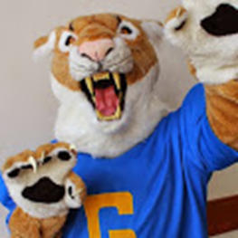
8. Provide Alternate Text
Do not use an image of text, unless it is only decorative
If it isn’t text, it isn’t readable by assistive technologies.
If you do, it must have alternate text
3 Ways to Provide Alternate Text
Preceding Text
Text leading up to non-text item (image, etc.)
Caption
Underneath images
Above charts and tables
Alt Text command
Select non-text item > Right Click > Select Format [picture | table | chart]
Further Instruction: Visit Online Learning Faculty Resources to view Adding Alternate Text to Microsoft Documents for Accessibility (pptx, 1.3MB)
Demo Needed?
Figure 1: GCC Mascot
(Caption example)
Notes:
Self-explanatory, alternate text is a text alternative for a non-text item, such as an image, art (clip art, smart art), chart, table, etc.
See link for presentation just on adding Alternate Text.
Demo? What ‘fix’ can I use to quickly find Missing Alt Text Errors?

Slide 35
9. The More Ways the Better!
Add multiple file types
Allows students using assistive technologies to choose
.pdf is best for displaying a file on-line. Text based pdf can be used with text-to-speech software.
.doc or docx is used with text-to-speech software or braille display
.rtf is best for those with vision loss or using a braille display
Allow for assignments to be of any type
As long as the way the assignment is done doesn’t matter
Content is important, the file type can be flexible
Notes:
Pdf is a good file type choice. Either have the original document format available upon request or simply add it as an alternative.
Instructors are surprised (usually pleasantly) at student creativity when allowed to express it in the format of their choice.

Slide 36
More Ways Continued
The more places something is, the better the chance it will be read:
Repeat: Put the Accessibility Statement in multiple places
Put Due Dates in Syllabus, Schedule, and Announcements
The more places something is, the easier it can be found
Blackboard courses can have items in multiple places:
Add Individual folders to hold all PowerPoints, all Videos, all etc.
Let students have choices so those with disabilities do not have to ask for something
Notes:
Repeat: Put the Accessibility Statement in multiple places:
Introductory Letter or Introduction Statement
Syllabus
On Blackboard

Slide 37
10. Consistency, Consistency, Consistency…
Once items are consistent throughout your course, it will also be predictable
Students know where to find content
Students can predict what comes next
When the first module or week is consistent with the rest, the content is predictable as what will be found in each
Notes:
Consistency and predictability can help avoid anxiety especially for those with learning disabilities.

Slide 38
More Ways to be Consistent
Naming of files need to be consistent and descriptive.
Good practice is to start with Course ID (ex. HIS100-Syllabus)
Students in multiple courses can quickly identify the file they want by filename, by the Heading, by the content
The More Ways the Better!
HIS100-Syllabus-Fall2016 (pdf, 100KB)
HIS100-Chapter1-Homework (pdf, 60KB)
HIS100-Chapter1-Quiz1 (pdf, 86KB)
…
Notes:
The filename, document Heading, and content should all tell the reader what they are reading.
HIS100-Syllabus-Fall2016 when open should have HIS100 Introduction to History as the Heading or close to the top, and the content should be consistent with the title and as it suggests contain Syllabus information.

Slide 39
And More Ways to be Consistent
Consistent Highlighting
For example, bolding all due dates makes it easy to find the due date!
HIS100 Quiz Chapter 1 due November 20
HIS100 Paper Chapter 1 due November 30
HIS100 Test Chapter 1 due December 18
- Or in table format or table format with caption at the top options:
Assignment | Chapter(s) | Due Date
HIS100 Quiz | Chapter 1 | November 20
HIS100 Quiz | Chapter 2 | November 30
HIS100 Test | Chapter 1 & 2 | December 18
Chapter 1 Assignments and Due Dates:
Assignment | Due Date
HIS100 Quiz | November 20
HIS100 Paper | November 30
HIS100 Test | December 18

Slide 40
And Even More Ways to be Consistent
Be consistent with your layout of pages, slides, etc.
Use Headings and Built-Ins (Fix # 3)
For PowerPoint:
Keep the Layout – that’s a built-in for Microsoft PowerPoint
Maintain consistency for the slides
If you keep changing the sizes from the default Titles and text boxes, transitioning between slides causes unevenness and you could lose valuable white space.
Check the Outline
View > Normal Presentation View (this is the default view), select Outline tab
Shows text only information from the slide layouts

Slide 41
Accessibility Mantra
Making it accessible for those with disabilities makes it accessible for all!

Slide 42
Agenda Topic 3
Questions?

Slide 43
Agenda Topic 4
The Top 10 Relisted: Demo?

Slide 44
The Top 10 List: Demo?
Link to Accessibility Statement
Keep Content Simple
Use Headings (Styles)
Use Color and Contrast Thoughtfully
Review Accessibility Checker Suggestions
Audio & Video Need Transcripts or Captioning
Hyperlinks Need to Make Sense
Provide Alternate Text
The More Ways the Better!
Consistency, Consistency, Consistency…
Notes:
Open Accessibility Self-Review Checklist (www.genesee.edu/cms/home/assets/File/Accessibility%20Self%20Review%20Checklist.docx) to show:
Accessibility Statement
Keep Content Simple
Headings
Color and Contrast
as above and open Blackboard Sandbox to show themes
5. Accessibility Checker – use this document (File > Info > Check for Issues > Check Accessibility)
7. Hyperlink – example on Slide 8, Slide 30
8. Alternate Text – See Slide 14 and 17 with Alt Text and Slide 18 without Alt Text. Slide 19 shows both.
9. The More Ways the Better!
10. Consistency, Consistency, Consistency…

Slide 45
Agenda Topic 5
Kiosk Demo

Slide 46
Vision Accessibility Experience
Most of us know of someone personally who is color-blind or has a vision problem.
Step into the shoes (or try on glasses) of someone who may or may not disclose this type of disability!
Visit the Kiosk
Instructions:
Put on a pair of glasses and view the picture
Remove the glasses to see the differences in color
Put on the other pair of glasses and view the same picture

Slide 47

Feedback Is Appreciated
Thank You!
Notes:
Feedback forms are available to fill out or send comments to GCConline@genesee.edu

